Slide 1
Ethics
CSE 591 – Security and Vulnerability Analysis
Spring 2015
Adam Doupé
Arizona State University
http://adamdoupe.com

Slide 2
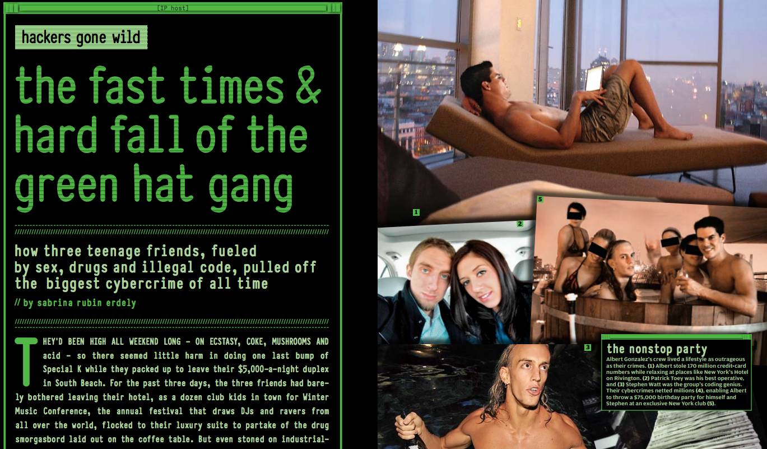

Slide 3
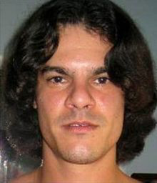
Albert Gonzalez

Slide 4
Albert Gonzalez
He and his crew used SQL injection vulnerabilities to steal credit cards
Total stolen ~ 170 million credit cards
Responsible for
  Dave & Busters (May 2008)
  TJ Maxx (May 2008)
  Heartland Payment (August 2009)
On March 25th, 2010 he was sentenced to 20 years in federal prison

Slide 5
Avoiding Jail
Pretty easy, don't do anything illegal!
What does this mean in a hacking context?
  Never hack into a site that you do not own or have permission
  Do not attempt to find vulnerabilities in a site that you do not own or have permission

Slide 6
Practicing Without Going to Jail
Download website source onto a server that you control (assuming the website is open-source)
Only try to find vulnerabilities in a site that has a bug bounty program
Become an academic
  We can sometimes do vulnerability analysis, however we are very careful to consider the ethical considerations before performing any analysis

Slide 7
Bug Bounty Programs
A number of web sites have started to offer Bug Bounty programs
They will give you money or fame in exchange for reporting security vulnerabilities to them
  Make sure that they also give you permission, and make sure you understand what is in scope
Google, Facebook, AT&T, Coinbase, Etsy, Github, Heroku, Microsoft, Paypal,
  https://bugcrowd.com/list-of-bug-bounty-programs

Slide 8
Facebook Incident
Security researcher found vulnerability in Facebook to post on anyone's wall
Breakdown in communication with Facebook's security team
Researcher decided to post on Mark Zuckerberg's wall to get attention about the vulnerability
Ultimately, Facebook said that the researcher did not follow the policy and therefore was ineligible for bounty

Slide 9
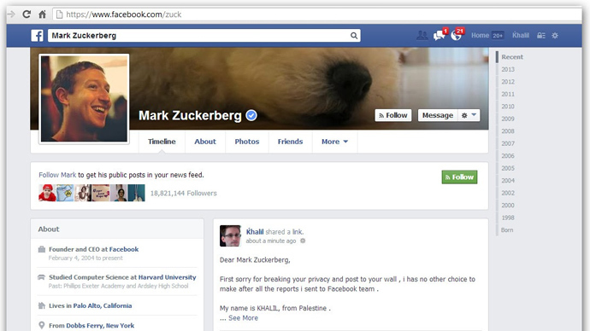

Slide 10
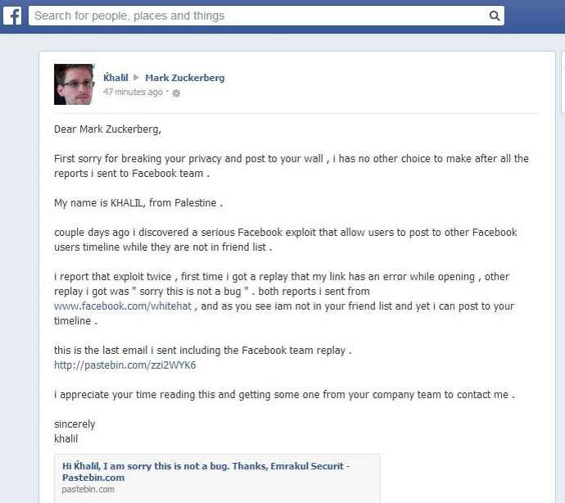

Slide 11
Disclosure
In case you do find a vulnerability in software, what is your responsibility?
  Tell the world (full disclosure)
  Tell the company/group responsible for the software (responsible disclosure)
  Sell the information to the grey or black market (no disclosure)
Personal decision
  I believe in responsible disclosure, first disclosing to the company then releasing the information publically

Slide 12
Summary
Proceed ethically
Only attempt to find vulnerabilities in web applications that you either
  Control
  Have permission
Jail is a possibility
Also against ASU policy

