Slide 1
Modern Web Application Frameworks
CSE 591 – Security and Vulnerability Analysis
Spring 2015
Adam Doupé
Arizona State University
http://adamdoupe.com

Slide 2
Overview
We've seen how the web works
  URIs
  HTTP
  HTML
We looked at how to dynamically generate HTML pages
  Server-side code languages
  SQL databases
We've looked at how to dynamically modify HTML on the client's machine
  JavaScript

Slide 3
How to Design a Web Application
Depends on the framework you use
CGI applications
  One single file that responds to multiple path infos (ala Assignment 1 Part 3)
  Multiple files that each respond to their own path
PHP applications
  Typically many files that correspond 1-1 with a URL
ASP applications
  Classic ASP is the same as PHP

Slide 4
"Natural" PHP code
<?php
session_start();
$_SESSION['username'] = 'admin';
$username_param = $_GET['username'];
if ($username_param != $_SESSION['username'])
{
if ($_SESSION['username'] != 'admin')
{
echo "<h1>Sorry, you can only view your own comments.</h1>";
exit(0);
}
}
$username = $_SESSION['username'];
?>

Slide 5
"Natural" PHP code
<h1>CS 177 Comments</h1>
<h2>Welcome <?php echo $username; ?>
<p>for debugging purposes you are: <span id='userinfo'><?php echo $_SESSION['loggedin2']; ?></span></p>
<h2>Here are the comments</h2>
<?php
$db = sqlite_open("comments.sqlite");
$query = "select * from comments where username = '" . sqlite_escape_string($username_param) . "';";
$res = sqlite_query($query, $db);
if ($res)
{
while ($entry = sqlite_fetch_array($res, SQLITE_ASSOC))
{
?>
<p><?php echo $entry['comment']; ?>
<br />- <?php htmlspecialchars($username); ?>
</p>
<?php
}
?>

Slide 6
"Natural" PHP code
<h2>Make your voice heard!</h2>
<form action="add_comment.php?username=<?php echo urlencode($username); ?>" method="POST">
<textarea name="comment"></textarea> <br>
<input type="submit" value="Submit" />
</form>
<p>
<a href="logout.php">Logout</a>
</p>
<?php
}
else
{
?>
<h1>Error</h1><p> <?php echo htmlspecialchars(sqlite_error_string(sqlite_last_error($db))); ?> </p>
<?php
}
?>

Slide 7
Spaghetti Code
How maintainable is this code?
  Imagine all the files are like this
  You want to change how comments are stored, giving them extra metadata
  You must change every single SQL query in every PHP files that touches the comments, as well as all the outputs
HTML output intermixed with SQL queries intermixed with PHP code

Slide 8
Tight Coupling URLs to Scripts
The natural way to design a web application is to map every (vaild) URL to a specific script that gets executed
URLs look like:
  http://example.com/add_comment.php
  http://example.com/view_comments.php
  http://example.com/users/view_users.php
  http://example.com/admin/secret.php
And map directly to the following file structure
  add_comment.php
  view_comments.php
  users/view_users.php
  admin/secret.php
Is this necessary?

Slide 9
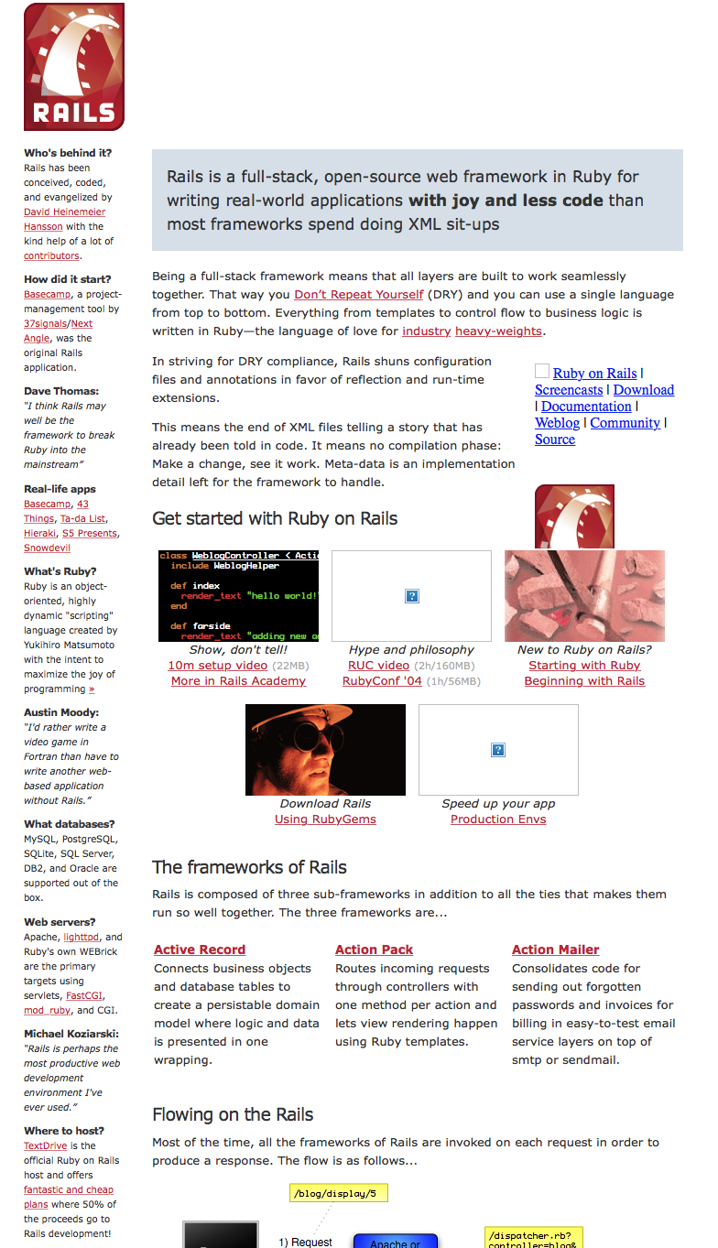

Slide 10
Model-View-Controller
User Interface design framework
  A way to separate the concerts of a GUI
  Originally created in the early '90s
Popularized by Ruby on Rails to structure the server-side code of web applications

Slide 11
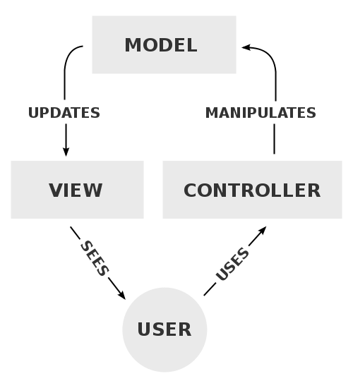

Slide 12
Separation of Concerns
Model
  Handles all the "business logic" of the application
  Stores the application state
View
  Responsible for generating a view for the user of the data from the model
  Usually a simple templating system to display the data from the model
Controller
  Responsible for taking input from the user, fetching the correct data from the model, then calling the correct view to display the data
  Should be very simple

Slide 13
Object Relational Mapping
As a programmer, you don't need to worry about the database or "SQL" language
Rails (ActiveRecord)
  user = User.create(name: "David", occupation: "Code Artist")
  david = User.find_by(name: 'David')
  david.destroy()
  Article.where('id > 10').limit(20).order('id asc')

Slide 14
Routing
Define a mapping between URLs and server-side functions
Also define parameters that get passed to the function from the URL
Rails example:
class BooksController < ApplicationController
def update
@book = Book.find(params[:id])
if @book.update(book_params)
redirect_to(@book)
else
render "edit"
end
end
end

Slide 15
Routing
class BooksController < ApplicationController
def index
@books = Book.all
end
end

Slide 16
Templating
Define the view as a simplified language
  Input: well-defined variables or dictionaries
  Output: HTML (or JSON or XML, …)
Ruby on Rails uses ERB:
<h1>Listing Books</h1>
…
<% @books.each do |book| %>
<tr>
<td><%= book.title %></td>
<td><%= book.content %></td>
<td><%= link_to "Show", book %></td>
<td><%= link_to "Edit", edit_book_path(book) %></td>
<td><%= link_to "Remove", book, method: :delete, data: { confirm: "Are you sure?" } %></td>
</tr>
<% end %>
…
<%= link_to "New book", new_book_path %>

Slide 17
Modern Web Application Frameworks
Many different frameworks for all languages (not a comprehensive list)
Ruby
  Ruby on Rails
Python
  Django
  Flask
PHP
  CakePHP
ASP
  ASP.NET MVC
Java
  Spring MVC

Slide 18
Homework Submission System

