Slide 1
Server-Side Web Applications
CSE 591 – Security and Vulnerability Analysis
Spring 2015
Adam Doupé
Arizona State University
http://adamdoupe.com
Content of some slides provided by Giovanni Vigna of UCSB, with approval

Slide 2
Overview
So far, we've examined the three main protocols underpinning the web
  URI/URL
  HTTP
  HTML
What we've studied has been a distributed document retrieval system
  This is the historical basis for the web
Notes:
Consider, how distributed is the web? How does it compare to DNS?

Slide 3
Web Applications
It was quickly realized that the way the web was structured allowed for returning dynamic responses
Early web was intentionally designed this way, to allow organizations to offer access to a database via the web
Basis of GET and POST also confirm this
  GET "SHOULD NOT have the significance of taking an action other than retrieval"
    Safe and idempotent
  POST
    Annotation of existing resources; posting a message to a bulletin board, newsgroup, mailing list, or similar group of articles, providing a block of data, such as the result of submitting a form, to a data-handling process; and extending a database through an append operation

Slide 4
Web Applications
Server-side code to dynamically create an HTML response
How does this differ from a web site?
In the HTTP protocol we've looked at so far, each request is distinct
  Server has client IP address and User-Agent

Slide 5
Maintaining State
HTTP is a stateless protocol
However, to write a web application we would like maintain state and link requests together
The goal is to create a "session" so that the web application can link requests to the same user
  Allows authentication
  Rich, full applications
Three ways this can be achieved
  Embedding information in URLs
  Using hidden fields in forms
  Using cookies
Notes:
While the last option is the most common, it's important to get an understanding of where we came from. Plus, there might be applications that use the other two features.

Slide 6
Embedding Information in URLs
When a user requests a page, the application embeds a unique identifier in every link contained in the HTML page returned to the user
First client request:
  GET /login.php?user=foo&pwd=bar HTTP/1.1
Server HTML reply:
  <html>
  …
  <a href="account.php?user=foo">account</a>
  <a href="calendar.php?user=foo">calendar</a>
  </html>

Slide 7
Embedding Information in URLs
What happens when user sends a link to someone else?
Is the session secure?
What does the session security depend on?
Is this in use today?

Slide 8

Embedding Information in Forms
If a user has to go through a number of forms, information can be carried through using hidden input tags
  The hidden attribute on an input hides the box from the user, but the value is still submitted
First client request:
  GET /login.php?user=foo&pwd=bar HTTP/1.1
Server HTML reply:
  <html>
  <form action="/calendar.php" method=POST>
  <input type="hidden" name="user" value="foo">
  <input type="submit" value="See the calendar!">
  </form>
  </html>
What will this form look like?

Slide 9
Embedding Information in Forms
How does this compare with embedding information in URLs?
Is the session secure?
What does the security of the session depend on?
Is this in use today?

Slide 10
Embedding Information in Cookies
Cookies are state information that is passed between a web server and a user agent
  Server initiates the start of a session by asking the user agent to store a cookie
  Server or user agent can terminate the session
Cookies first defined by Netscape while attempting to create an ecommerce application
RFC 2109 (February 1997) describes first standardization attempt for cookies
RFC 2965 (October 2000) tried to standardize cookies 2.0
RFC 6265 (April 2011) describes the actual use of cookies in the modern web and is the best reference

Slide 11
Embedding Information in Cookies
Cookies are name-value pairs (seperated by "=")
Server includes the "Set-Cookie" header field in an HTTP response
  Set-Cookie: USER=foo;
User agent will then send the cookie back to the server using the "Cookie" header on further requests to the server
  Cookie: USER=foo;

Slide 12
Embedding Information in Cookies
Server can ask for multiple cookies to be stored on the client, using multiple "Set-Cookie" headers
  Set-Cookie: USER=foo;
  Set-Cookie: lang=en-us;

Slide 13
Embedding Information in Cookies
Server can sent several attributes on the cookie, these attributes are included in the Set-Cookie header line, after the cookie itself, separated by ";"
  Path
    Specifies the path of the URI of the web server that the cookies are valid
  Domain
    Specifies the subdomains that the cookie is valid
  Expires or Max-Age
    Used to define the lifetime of the cookie, or how long the cookie should be valid
  HttpOnly
    Specifies that the cookie should not be accessible to client-side scripts
  Secure
    Specifies that the cookie should only be sent over secure connections

Slide 14
Embedding Information in Cookies
Example cookie headers from curl request to www.google.com
  curl -v http://www.google.com
Set-Cookie: PREF=ID=db9539b9b7353be5:FF=0:TM=1421424672:LM=1421424672:S=OqGXMZZhmeyihyKi; expires=Sun, 15-Jan-2017 16:11:12 GMT; path=/; domain=.google.com
Set-Cookie: NID=67=bs1lLyrXtfdUj79IlcuqR7_MWEsyNdLWU_FpGKwlWR9QpEzi3UrVV2UGO6LBW3sJNk9mlLcYIJns3PG3NUu-M3pT9qD-V4F8oyyJ_UJnCGKDUDGbllL9Ha8KGufv0MUv; expires=Sat, 18-Jul-2015 16:11:12 GMT; path=/; domain=.google.com; HttpOnly

Slide 15
Set-Cookie: PREF=ID=db9539b9b7353be5:FF=0:TM=1421424672:LM=1421424672:S=OqGXMZZhmeyihyKi; expires=Sun, 15-Jan-2017 16:11:12 GMT; path=/; domain=.google.com
  expires is set two years in the future
  path is / which means to send this cookie to all subpaths of www.google.com/
  domain is .google.com, which means to send this cookie to all subdomains of .google.com
    Includes www.google.com, drive.google.com, …

Slide 16
Set-Cookie: NID=67=bs1lLyrXtfdUj79IlcuqR7_MWEsyNdLWU_FpGKwlWR9QpEzi3UrVV2UGO6LBW3sJNk9mlLcYIJns3PG3NUu-M3pT9qD-V4F8oyyJ_UJnCGKDUDGbllL9Ha8KGufv0MUv; expires=Sat, 18-Jul-2015 16:11:12 GMT; path=/; domain=.google.com; HttpOnly
  HttpOnly is a security feature, which means only send this cookie in HTTP, do not allow JavaScript code to access the cookie

Slide 17
Embedding Information in Cookies
The server can request the deletion of cookies by setting the "expires" cookie attribute to a date in the past
User agent should then delete cookie with that name
  Set-Cookie: USER=foo; expires=Thu, 1-Jan-2015 16:11:12 GMT;
    User agent will then delete the cookie with name "USER" that is associated with this domain
  Proxies are not supposed to cache cookie headers
    Why?

Slide 18
Embedding Information in Cookies
User agent is responsible for following the server's policies
  Expiring cookies
  Restricting cookies to the proper domains and paths
However, user agent is free to delete cookies at any time
  Space/storage restrictions
  User decides to clear the cookies

Slide 19
Modern Sessions
Sessions are used to represent a time-limited interaction of a user with a web server
There is no concept of a "session" at the HTTP level, and therefore it has to be implemented at the web application level
  Using cookies
  Using URL parameters
  Using hidden form fields
In the most common use of sessions, the server generates a unique (random and unguessable) session ID and sends it to the user agent as a cookie
On subsequent requests, user agent sends the session ID to the server, and the server uses the session ID to index the server's session information

Slide 20
Designing Web Applications
In the early days of the web, one would write a "web application" by writing a custom web server that received HTTP requests, ran custom code based on the URL path and query data, and returned a dynamically created HTML page
  The drawback here is that one would have to keep the web server up-to-date with the latest HTTP changes (HTTP/1.1 spec is 175 pages)
Generally decided that it was a good idea to separate the concerns into a web server, which accepted HTTP request and forwarded relevant requests to a web application
  Could develop a web application without worrying about HTTP

Slide 21




Web Application Overview
HTTP Request
HTTP Response
Web Application
Web Server
Client

Slide 22
The Common Gateway Interface
Defines an interface between the web server and a program on the web server that should receive the request
The program's output is returned to the client
CGI developed by NCSA (National Center for Supercomputing Applications at University of Illinois, Urbana-Champaign) around 1993
  NCSA created the Mosaic web browser, which eventually turned into the Netscape browser
  NCSA also created the server component NCSA HTTPd, which eventually became the Apache HTTP server
CGI 1.1 defined in RFC 3875 (October 2004)

Slide 23
CGI
Input parameters can be passed
  Using the URL (GET method)
    Query can be stored as a URL
  Using the request body (POST method)
    Request body is sent as stdin to the CGI program
    Input parameters can be of any size
http://example.com/cgi-bin/test.tcl/usr/info?choice=yes&q=high
CGI
Directory
Program
Extra Path
Query Data

Slide 24
CGI Programs
Can be written in any language
  As long as the server can execute the program (permissions are correct, etc.)
Input to the program (the HTTP request body) is piped to the process' stdin
Other request metadata are passed by setting standard environment variables
  REQUEST_METHOD: GET, POST, HEAD, …
  PATH_INFO: path in the URL that follows the program name and precedes "?"
  QUERY_STRING: information that follows "?"
    Encoded using previously discussed application/x-www-form-urlencoded
    name=value pairs separated by "&", name and value are percent encoded
  CONTENT_TYPE: MIME type of the data for a POST request
  CONTENT_LENGTH: size of the data for the POST request
  HTTP_<field>: value of the corresponding HTTP request header

Slide 25
CGI Variables
SERVER_SOFTWARE : name/version of server software
SERVER_NAME : server hostname
GATEWAY_INTERFACE : CGI version
SERVER_PROTOCOL : server protocol version
SERVER_PORT : TCP port used by the server
PATH_TRANSLATED : PATH_INFO for non-Unix OSs
SCRIPT_NAME : name of the script
REMOTE_HOST : hostname of the client
REMOTE_ADDR : address of the client
AUTH_TYPE : authentication mechanism used
REMOTE_USER : authenticated user name
REMOTE_IDENT : user name as returned by identd

Slide 26
CGI Output
CGI output is not HTTP output
Format of CGI program response is headers, separated by newlines (\n)
Body follows headers after blank line
The only required header is Content-Type
Status header is optional
  200 OK assumed
Web server then translates the CGI output to HTTP output for the client
  Includes Content-Length and other headers

Slide 27
CGI Hello World
#!/usr/bin/perl print "Content-type: text/html\n\n"; print "Hello, World.";
Note: program taken from the Apache documentation

Slide 28
CGI from the Command Line
ubuntu:~$ /usr/lib/cgi-bin/first.pl
Content-type: text/html
Hello, World.

Slide 29
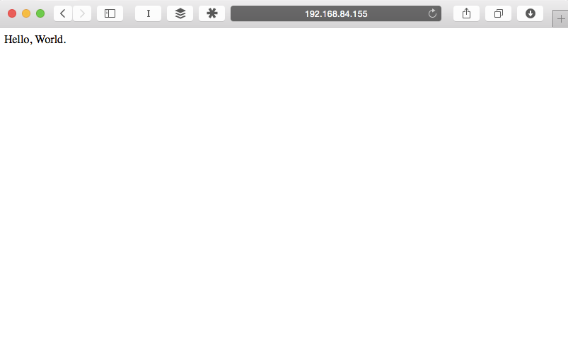
http://192.168.84.155/cgi-bin/first.pl

Slide 30
GET /cgi-bin/first.pl HTTP/1.1
User-Agent: curl/7.37.1
Host: 192.168.84.155
Accept: */*
HTTP/1.1 200 OK
Date: Fri, 16 Jan 2015 19:31:53 GMT
Server: Apache/2.4.7 (Ubuntu)
Content-Length: 13
Content-Type: text/html
Hello, World.

Slide 31
Complicated Example
<!DOCTYPE html>
<html>
<head><title>Search Page</title></head>
<body>
<h1>Search Page</h1>
<form action="/cgi-bin/search.pl" method="get">
Search: <input type="text" name="keyword">
<input type="submit" value="search"></form>
</body>
</html>

Slide 32
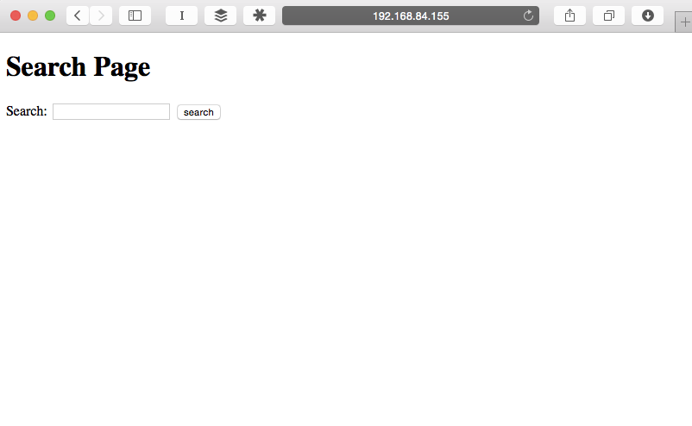
http://192.168.84.155/

Slide 33
search.pl
#!/usr/bin/perl
use CGI qw/:standard/;
$file="users.txt";
$keyword = param('keyword');
print "Content-type: text/html\n";
print "\n";
print "<html><head><title>Search Results</title></head><body>\n";
print " <h1>Search Results</h1>\n";
print " <hr />\n";
open(FILE, $file);
while (<FILE>) {
if ($_ =~ /$keyword/) {
print "$_<br />";
}
}
print " <hr /></body>\n</html>\n";

Slide 34
http://192.168.84.155/

Slide 35
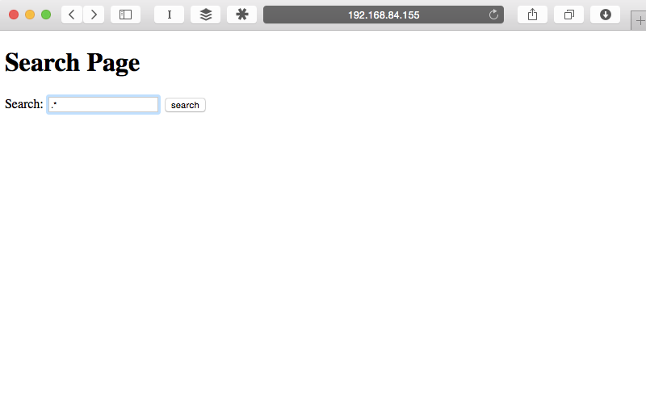
http://192.168.84.155/

Slide 36
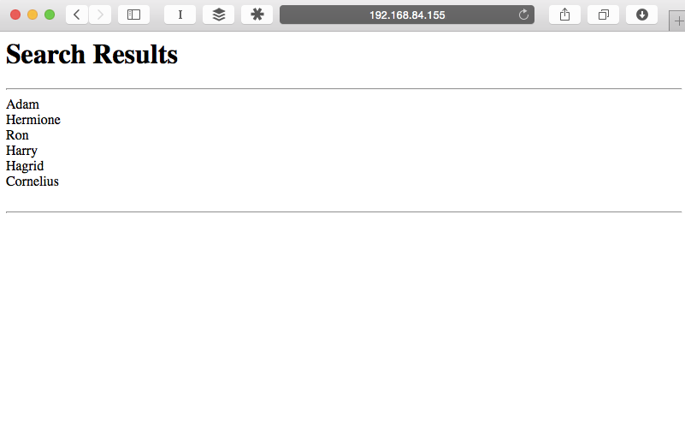
http://192.168.84.155/cgi-bin/search.pl?keyword=.*

Slide 37
GET /cgi-bin/search.pl?keyword=.* HTTP/1.1
User-Agent: curl/7.37.1
Host: 192.168.84.155
Accept: */*
HTTP/1.1 200 OK
Date: Fri, 16 Jan 2015 19:56:43 GMT
Server: Apache/2.4.7 (Ubuntu)
Vary: Accept-Encoding
Transfer-Encoding: chunked
Content-Type: text/html
<html><head><title>Search Results</title></head><body>
<h1>Search Results</h1>
<hr />
Adam
<br />Hermione
<br />Ron
<br />Harry
<br />Hagrid
<br />Cornelius
<br />
<br /> <hr /></body>
</html>

Slide 38
Recap
Embedding information in URLs
Embedding information in forms
Chunked encoding

Slide 39
Active Server Pages (ASP)
Microsoft's answer to CGI scripts
First version released in 1996
Syntax of a program is a mix of
  Text
  HTML Tags
  Scripting directives (VBScript Jscript)
  Server-side includes (#include, like C)
Scripting directives are interpreted and executed at runtime
Will be supported "a minimum of 10 years from the Windows 8 release date"
  October 26th, 2022

Slide 40
ASP Example
<% strName = Request.Querystring("Name")
If strName <> "" Then %>
<b>Welcome!</b>
<% Response.Write(strName)
Else %>
<b>You didn't provide a name...</b>
<% End If %>

Slide 41
Web Application Frameworks
As the previous Request.Querystring example shows, frameworks were quickly created to assist web developers in making web applications
Frameworks can help
  Ease extracting input to the web application (query parameters, form parameters)
  Setting/reading cookies
  Sessions
  Security
  Database

Slide 42
Web Application Frameworks
Important to study web application frameworks to understand the (security) pros and cons of each
Some vulnerability classes are only present in certain frameworks

Slide 43
Java Servlets
Sun's improvement over CGI scripts
  You can write a Java program as a CGI script
  Java interpreter started with every request
  Whole Java interpreter and program copied into memory on every request
First servlet 1.0 released in June 1997
  In typical Java fashion, the "servlet" concept is abstract way to extend a server to respond to a request
  Most typical way it's used is "HTTP Servlet," which is also referred to as a servlet

Slide 44
Java Servlets
Servlet specification defines an interface that a class must implement to respond to requests
Servlet "lives" inside a hosting server
Each request is handled by a separate thread
  Thus reducing the overhead of each request
Can also share state between requests, by sharing data between threads

Slide 45
Java Servlets – Example
import java.io.*;
import javax.servlet.*;
import javax.servlet.http.*;
public class Helloworld extends HttpServlet {
private String message;
public void init() throws ServletException {
message = "Hello World";
}
public void doGet(HttpServletRequest request, HttpServletResponse response)
throws ServletException, IOException {
response.setContentType("text/html");
PrintWriter out = response.getWriter();
out.println("<h1>" + message + "</h1>");
}
}
http://stackoverflow.com/questions/18821227/how-to-write-hello-world-servlet-example

Slide 46
Java Servlets – Example
import java.io.IOException;
import javax.servlet.*;
import javax.servlet.http.*;
public class ServletLifeCycleExample extends HttpServlet {
private int count;
public void init(ServletConfig config) throws ServletException {
super.init(config);
count = 0;
}
protected void service(HttpServletRequest request, HttpServletResponse response)
throws ServletException, IOException {
count++;
response.getWriter().write("Incrementing the count: count = " + count);
}
}
http://en.wikipedia.org/wiki/Java_servlet

Slide 47
JavaServer Pages (JSP)
Sun's answer to ASP (and PHP)
Similar in syntax and spirit to ASP
  Mix HTML output and Java code
On first load, the Java server compiles the JSP page to a servlet
Released by Sun in June 1999

Slide 48
JSP – Example
<%@ taglib uri="http://java.sun.com/jsp/jstl/core" prefix="c" %>
<%@ taglib uri="http://java.sun.com/jsp/jstl/fmt" prefix="fmt" %>
<jsp:useBean id="date" class="java.util.Date" />
<!DOCTYPE html>
<html lang="en">
<head>
<title>JSP Hello World</title>
</head>
<body>
<h1>Hello</h1>
<p>Welcome, user from <c:out value="${pageContext.request.remoteAddr}" />
<p>It's now <fmt:formatDate value="${date}" pattern="MM/dd/yyyy HH:mm" />
</body>
</html>
http://stackoverflow.com/tags/jsp/info

Slide 49
PHP: Hypertext Preprocessor
Scripting language that can be embedded in HTML pages to generate dynamic content
  Basic idea is similar to JSP and ASP
Originally released in 1995 as a series of CGI scripts as C binaries
PHP 3.0 released June 1998 is the closest to current PHP
  "At its peak, PHP 3.0 was installed on approximately 10% of the web servers on the Internet" - http://php.net/manual/en/history.php.php
PHP 4.0 released May 2000
PHP 5.0 released July 2004
  Added support for objects
PHP 5.6 released August 2014 is the latest version

Slide 50
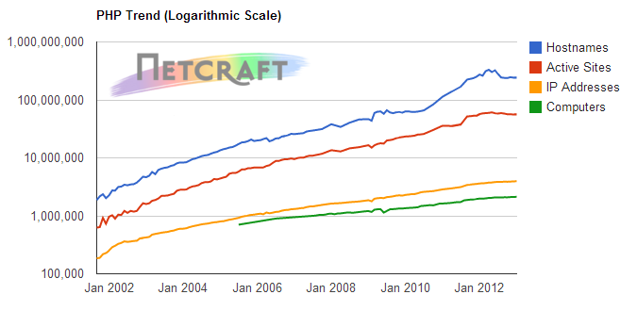
PHP – Popularity
http://news.netcraft.com/archives/2013/01/31/php-just-grows-grows.html

Slide 51
PHP
The page is parsed and interpreted on each page request
  Can be run as CGI, so that a new copy of the PHP interpreter is run on each request
  Or the PHP interpreter can be embedded into the web server
    mod_php for apache
Completely new language
  C-like in syntax
  Custom designed to build web applications
  Language grew organically over time

Slide 52
PHP – Example
<!DOCTYPE html>
<html>
<head>
<title>PHP Test</title>
</head>
<body>
<?php echo '<p>Hello World</p>'; ?>
</body>
</html>
http://en.wikipedia.org/wiki/PHP

Slide 53
PHP – Features
Dynamically typed
String variable substitution
Dynamic include/require
Superglobals
Variable variables
register_globals

Slide 54
PHP – String Variable Substitution
<?php
echo 'this is a simple string';
echo 'Variables do not $expand $either';
$juice = "apple";
echo "He drank some $juice juice.";
$juices = array("apple", "orange", "koolaid1" => "purple");
echo "He drank some $juices[0] juice.";
echo "He drank some $juices[1] juice.";
echo "He drank some $juices[koolaid1] juice.";
echo "This works: {$juices['koolaid1']}";
http://php.net/manual/en/language.types.string.php

Slide 55
PHP – Dynamic include/require
<?php
/**
* Front to the WordPress application. This file doesn't do anything, but loads
* wp-blog-header.php which does and tells WordPress to load the theme.
*
* @package WordPress
*/
/**
* Tells WordPress to load the WordPress theme and output it.
*
* @var bool
*/
define('WP_USE_THEMES', true);
/** Loads the WordPress Environment and Template */
require( dirname( __FILE__ ) . '/wp-blog-header.php' );

Slide 56
wp-blog-header.php
<?php
/**
* Loads the WordPress environment and template.
*
* @package WordPress
*/
if ( !isset($wp_did_header) ) {
$wp_did_header = true;
require_once( dirname(__FILE__) . '/wp-load.php' );
wp();
require_once( ABSPATH . WPINC . '/template-loader.php' );
}

Slide 57
allow_url_include
PHP setting to allow http and ftp urls to include functions
Must enable allow_url_fopen as well
  This setting allows calling fopen on a url
Remote file is fetched, parsed, and executed

Slide 58
PHP - Superglobals
<?php
if ( 'POST' != $_SERVER['REQUEST_METHOD'] ) {
header('Allow: POST');
header('HTTP/1.1 405 Method Not Allowed');
header('Content-Type: text/plain');
exit;
}
$comment_post_ID = isset($_POST['comment_post_ID']) ? (int) $_POST['comment_post_ID'] : 0;
$post = get_post($comment_post_ID);
if ( empty( $post->comment_status ) ) {
/**
* Fires when a comment is attempted on a post that does not exist.
* @since 1.5.0
* @param int $comment_post_ID Post ID.
*/
do_action( 'comment_id_not_found', $comment_post_ID );
exit;
}
// get_post_status() will get the parent status for attachments.
$status = get_post_status($post);
$status_obj = get_post_status_object($status);
Wordpress – wp-comments-post.php

Slide 59
PHP – Variable Variables
<?php
$a = 'hello';
$$a = 'world';
echo "$a $hello";
echo "$a ${$a}";
http://php.net/manual/en/language.variables.variable.php

Slide 60
PHP – register_globals
"To register the EGPCS (Environment, GET, POST, Cookie, Server) variables as global variables."
PHP will automatically inject variables into your script based on input from the HTTP request
  HTTP request variable name is the PHP variable name and the value is the PHP variable's value
Default enabled until 4.2.0 (April 2002)

Slide 61
PHP – register_globals
<html>
<head> <title>Feedback Page</title></head>
<body>
<h1>Feedback Page</h1>
<?php
if ($name && $comment) {
$file = fopen("user_feedback", "a");
fwrite($file, "$name:$comment\n");
fclose($file);
echo "Feedback submitted\n";
}
?>
<form method=POST>
<input type="text" name="name"><br>
<input type="text" name="comment"><br>
<input type="submit" name="submit" value="Submit">
</form>
</body>
</html>

Slide 62
Storing State
Web applications would like to store persistent state
  Otherwise it's hard to make a real application, as cookies can only store small amounts of information
Where to store the state?
  Memory
    Previous JSP example
  Filesystem
    Flat
    XML file
  Database
    Most common for modern web applications

Slide 63
Web Applications and the Database
Pros
  ACID compliance
  Concurrency
  Separation of concerns
    Can run database on another server
    Can have multiple web application processes connecting to the same database
Cons
  More complicated to build and deploy
  Adding another language to web technology (SQL)

Slide 64
LAMP Stack
Classic web application model
  Linux
  Apache
  MySQL
  PHP
Nice way to think of web applications, as each component can be mixed and swapped
  Underlying OS
  Web server
  Database
  Web application language/framework

Slide 65
MySQL
Currently second-most used open-source relational database
  What is the first?
First release on May 23rd 1995
  Same day that Sun released first version of Java
Sun eventually purchased MySQL (the company) for $1 billion in January 2008

Slide 66
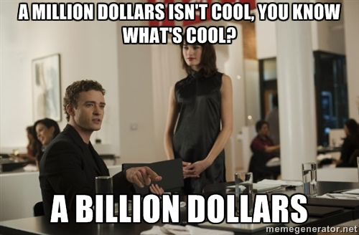

Slide 67
Structured Query Language
Special purpose language to interact with a relational database
Multiple commands
  SELECT
  UPDATE
  INSERT
Some slight differences between SQL implementations

Slide 68
SQL Examples
SELECT * FROM Users WHERE userName = 'adam';
SELECT * FROM Book WHERE price > 100.00 ORDER BY title;
SELECT isbn, title, price FROM Book WHERE price < (SELECT AVG(price) FROM Book) ORDER BY title;
INSERT INTO example (field1, field2, field3) VALUES ('test', 'N', NULL);
UPDATE example SET field1 = 'updated value' WHERE field2 = 'N';
(SELECT a FROM t1 WHERE a=10 AND B=1 ORDER BY a LIMIT 10) UNION (SELECT a FROM t2 WHERE a=11 AND B=2 ORDER BY a LIMIT 10);

Slide 69
PHP and MySQL
<?php
$link = mysql_connect('localhost', 'mysql_user', 'mysql_password');
if (!$link) {
die('Could not connect: ' . mysql_error());
}
mysql_select_db('example', $link);
$firstname = 'fred';
$lastname = 'fox';
$query = sprintf("SELECT firstname, lastname, address, age FROM friends
WHERE firstname='%s' AND lastname='%s'", $firstname, $lastname);
$result = mysql_query($query);
if (!$result) {
$message = 'Invalid query: ' . mysql_error() . "\n";
die($message);
}
while ($row = mysql_fetch_assoc($result)) {
echo $row['firstname'];
echo $row['address'];
}
http://php.net/manual/en/function.mysql-query.php

Slide 70
Server-Side Web Application Technologies
Cookies
CGI
ASP
Servlets
JSP
PHP
SQL

Slide 71
Technologies
URI
Percent Encoding
HTTP Request
HTTP Response
HTTP Authentication
HTML
HTML Character References
Form Urlencoding
Cookies
CGI
ASP
Servlets
JSP
PHP
SQL

