Slide 1
Ethics
CSE 545 – Software Security
Spring 2018
Adam Doupé
Arizona State University
http://adamdoupe.com

Slide 2
Avoiding Jail
Pretty easy, don't do anything illegal!
What does this mean in a hacking context?
  Never hack into a system that you do not own or have permission
  Do not attempt to find vulnerabilities in a system that you do not own or have permission

Slide 3
Practicing Without Going to Jail
Download source code onto a server/system that you control (assuming it is open-source)
Only try to find vulnerabilities in a system that has a bug bounty program
Become an academic
  We can sometimes do vulnerability analysis, however we are very careful to consider the ethical considerations before performing any analysis

Slide 4
Bug Bounty Programs
A number of web sites have started to offer Bug Bounty programs
They will give you money or fame in exchange for reporting security vulnerabilities to them
  Make sure that they also give you permission, and make sure you understand what is in scope
Google, Facebook, AT&T, Coinbase, Etsy, Github, Heroku, Microsoft, Paypal,
  https://bugcrowd.com/list-of-bug-bounty-programs

Slide 5
Facebook Incident
Security researcher found vulnerability in Facebook to post on anyone's wall
Breakdown in communication with Facebook's security team
Researcher decided to post on Mark Zuckerberg's wall to get attention about the vulnerability
Ultimately, Facebook said that the researcher did not follow the policy and therefore was ineligible for bounty

Slide 6
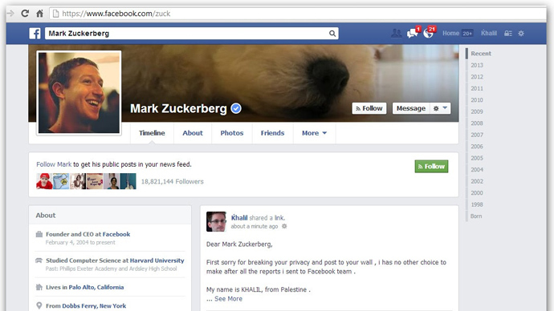

Slide 7
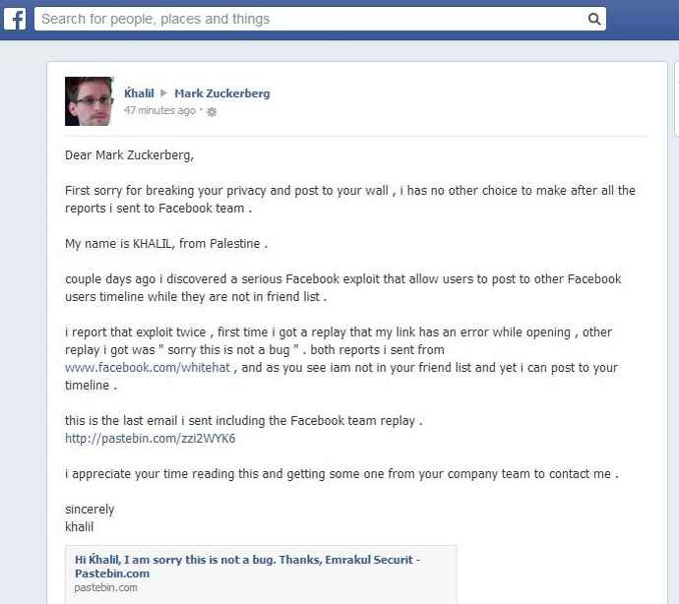

Slide 8
Disclosure
In case you do find a vulnerability in software, what is your responsibility?
  Tell the world (full disclosure)
  Tell the company/group responsible for the software (responsible disclosure)
  Sell the information to the grey or black market (no disclosure)
Personal decision
  I believe in responsible disclosure, first disclosing to the company then releasing the information publically

Slide 9
Would You Hire a Hacker?
Open problem and subject of much discussion
Pros: "I want somebody who can find problems before the bad guys do"
  Skillful, motivated, etc.
Cons: "I don’t want to hire an arsonist as a Fire Marshal"
  Problem with teamwork, may damage company, etc.
In general assessment of personality is important (morals, ethics, attitude)
  And hackers ARE hired all the time
How would you fire a hacker?

Slide 10
Legal Hacking: Penetration Testing
Vulnerability analysis followed by exploitation
  Assumptions and hypothesis derived from the analysis are verified on the field
  It is usually "black-box"
Penetration testing is part of the (larger) security auditing/analysis process
  Pentest/fix as a cycle is NOT a good way to ensure the security of a system
A comprehensive security analysis process takes into account many other aspects (e.g., source code analysis, policy analysis, social engineering)
  For example: The Open-Source Security Testing Methodology
    http://www.isecom.org/research/osstmm.html

Slide 11
Discussion: Is Penetration Testing Useful?

Slide 12
Summary
Proceed ethically
Only attempt to find vulnerabilities in web applications that you either
  Control
  Have permission
Jail is a possibility
Also against ASU policy

