Slide 1
Practical Security
Joaquin Fuentes
MBA, CEH, CPT, CISSP, CISA, NACA

Slide 2
About Joaquin
Manager, Penetration Testing @Early Warning
ASU Alumnus, 2001
OWASP Phoenix Chapter Leader
CTF winning team member, CactusCon & DefCon
@hackerbyhobby joaquin.fuentes@owasp.org

Slide 3
Dialogue Agenda
Hacking the “Catch 22”
Being a Hacker
Foundational Skills
Demonstrable Knowledge
Resources
“Try Harder”

Slide 4
Catch 22
Catch-22: A paradoxical situation from which an individual cannot escape because of contradictory rules.
An example would be:
"How am I supposed to gain experience [to be hired for a job] if I'm constantly turned down for not having any?"

Slide 5
*Spoiler Alert*
“Try Harder” - Offensive Security

Slide 6
Being a Hacker
hack·er
ˈhakər/
noun
noun: hacker; plural noun: hackers
  1 a person who uses computers to gain unauthorized access to data.
2 synonyms:
3 cybercriminal, pirate, computer criminal, keylogger, keystroke logger; informalcyberpunk, hacktivist "viruses that are the brainchildren of these malicious hackers"

Slide 7
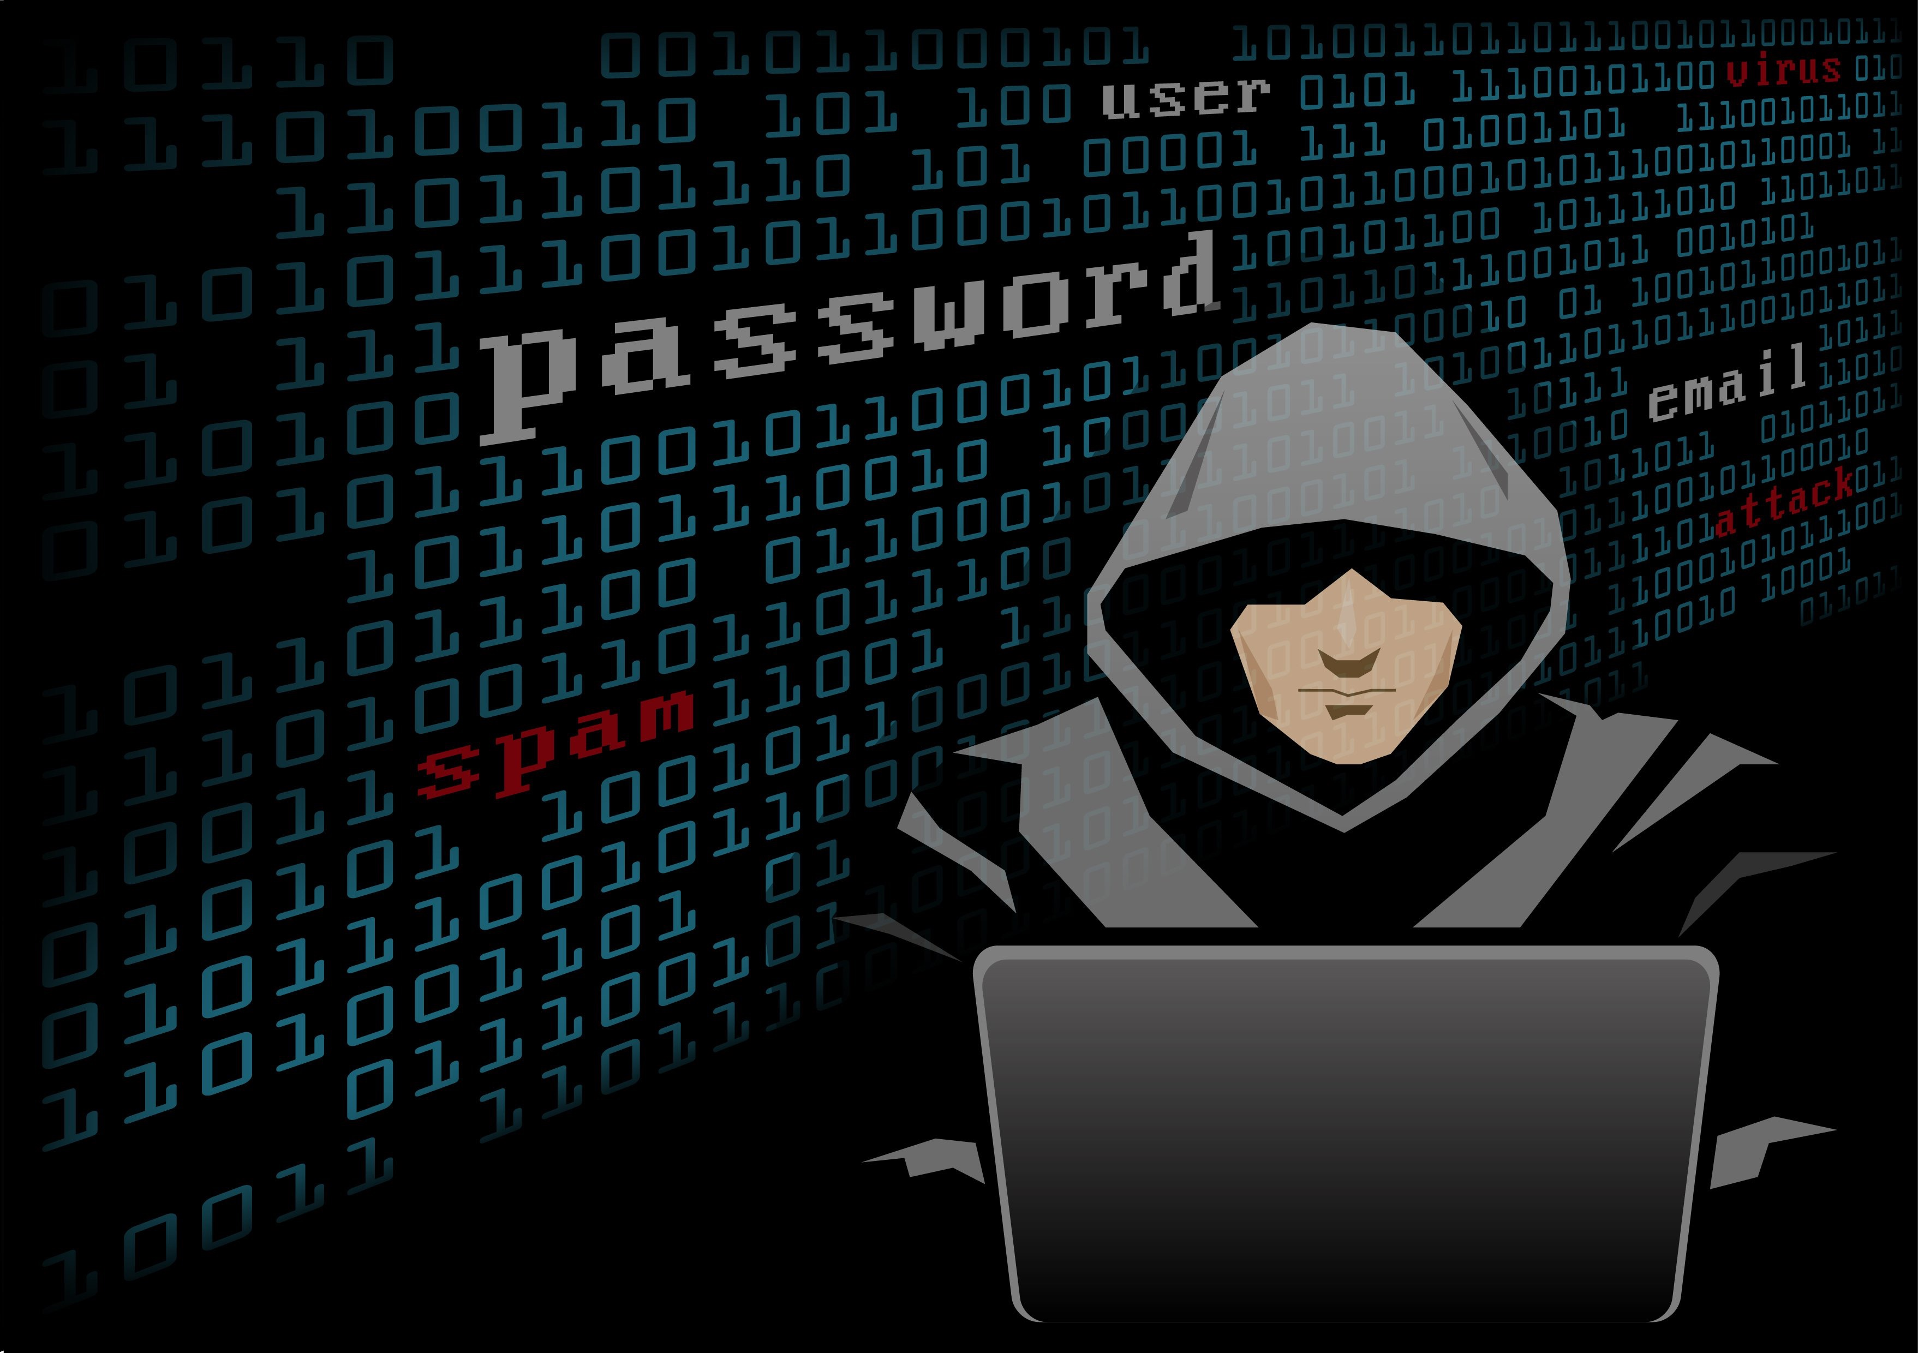
Being a Hacker
What your friends think you do:

Slide 8

Being a Hacker
What the world thinks you do:

Slide 9

Being a Hacker
What you actually do:

Slide 10
Being a Hacker
Example InfoSec Job Titles:
Penetration Tester
IT Auditor
Consultant
Security Architect
Security Engineer
CISO
Security Analyst
Developer
Network Security Specialist
Security Operations Analyst, SOC Analyst
Professor
Infrastructure Security Specialist

Slide 11
Being a Hacker
My Story …the short version
“War” Stories
Lessons Learned
  Focused, Self-training
  “Try Harder”

Slide 12
Foundational Skills
Be ethical
Networking Fundamentals
OSI Model
Development & Scripting
Linux & Windows
Web Servers
Web Applications
Web Services
Database Deployments
Transact SQL
Know Defensive Security
Recommendations

Slide 13
Demonstrable Knowledge
Have you performed the activity hands-on, more than a few times?
Can you walk me through some examples?
What tools can you describe using?
What are some best-practice defenses?
Describe recent major vulnerabilities

Slide 14
Demonstrable Knowledge
Networking Fundamentals
  NMap, ncat
OSI Model
  Know attacks & defense examples at each layer
Development & Scripting
  C, C++, Java, Python, .Net
Linux & Windows
  Kali Linux
Web Servers
  Apache, IIS, Nginx
Web Applications
  How to attack with a Proxy
Web Services
  SOAP, REST
Database Deployments
Transact SQL
Know Defensive Security
Recommendations
e.g. OWASP Recommendations

Slide 15
Resources
InfoSec News
CactusCon
OWASP
  Security Shephard
  ZAP
PentesterAcademy.com
Offensive-Security Blog
overthewire.org/wargames
  Bandit, Natas
Krebs On Security
ISSA, ISACA, SDSUG

Slide 16
Certification Providers
Some of the better ones…
Offensive Security
eLearnSecurity
Pentester Academy
PentesterLab

Slide 17
“Try Harder”
Plan to fail, don’t fail to plan
Get your degree
Stay focused
Get certifications
Participate in the Community

