Slide 1
Introduction to Information Assurance
CSE 365 – Information Assurance
Spring 2020
Adam Doupé
Arizona State University
http://adamdoupe.com

Slide 2
Introduction
Professor Adam Doupé
  PhD at UCSB
  Played CTF with Shellphish, then started the pwndevils @ ASU
    Next meeting Friday 8/23, 4pm BYENG 209
    http://pwndevils.com/
    https://pwndevils.slack.com/
TA Steven Wirsz
TA Arvind S Raj
TA Marzieh Bitaab

Slide 3

https://www.oooverflow.io/
https://github.com/o-o-overflow
https://twitter.com/oooverflow

Slide 4
Road to DEF CON 27 CTF
6 qualifying CTFs from around the world
1,200 teams competed in our qualification event in May

Slide 5
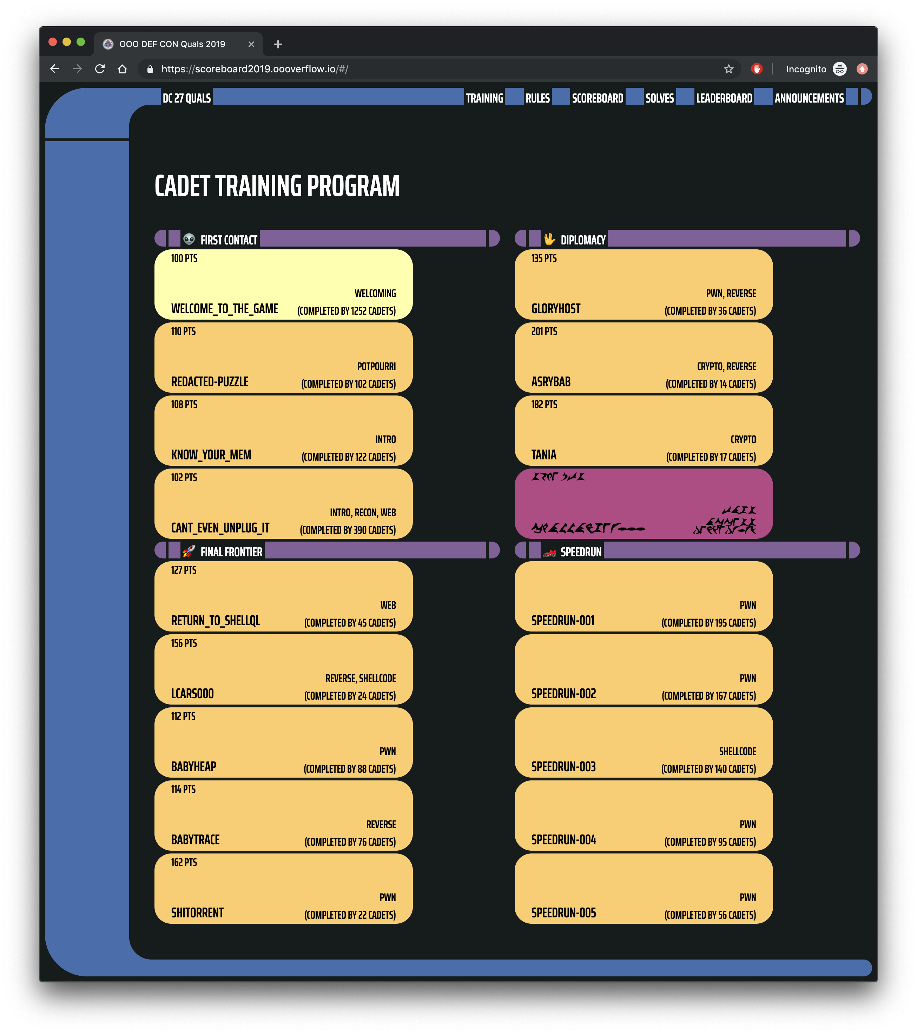
https://scoreboard2019.oooverflow.io/

Slide 6
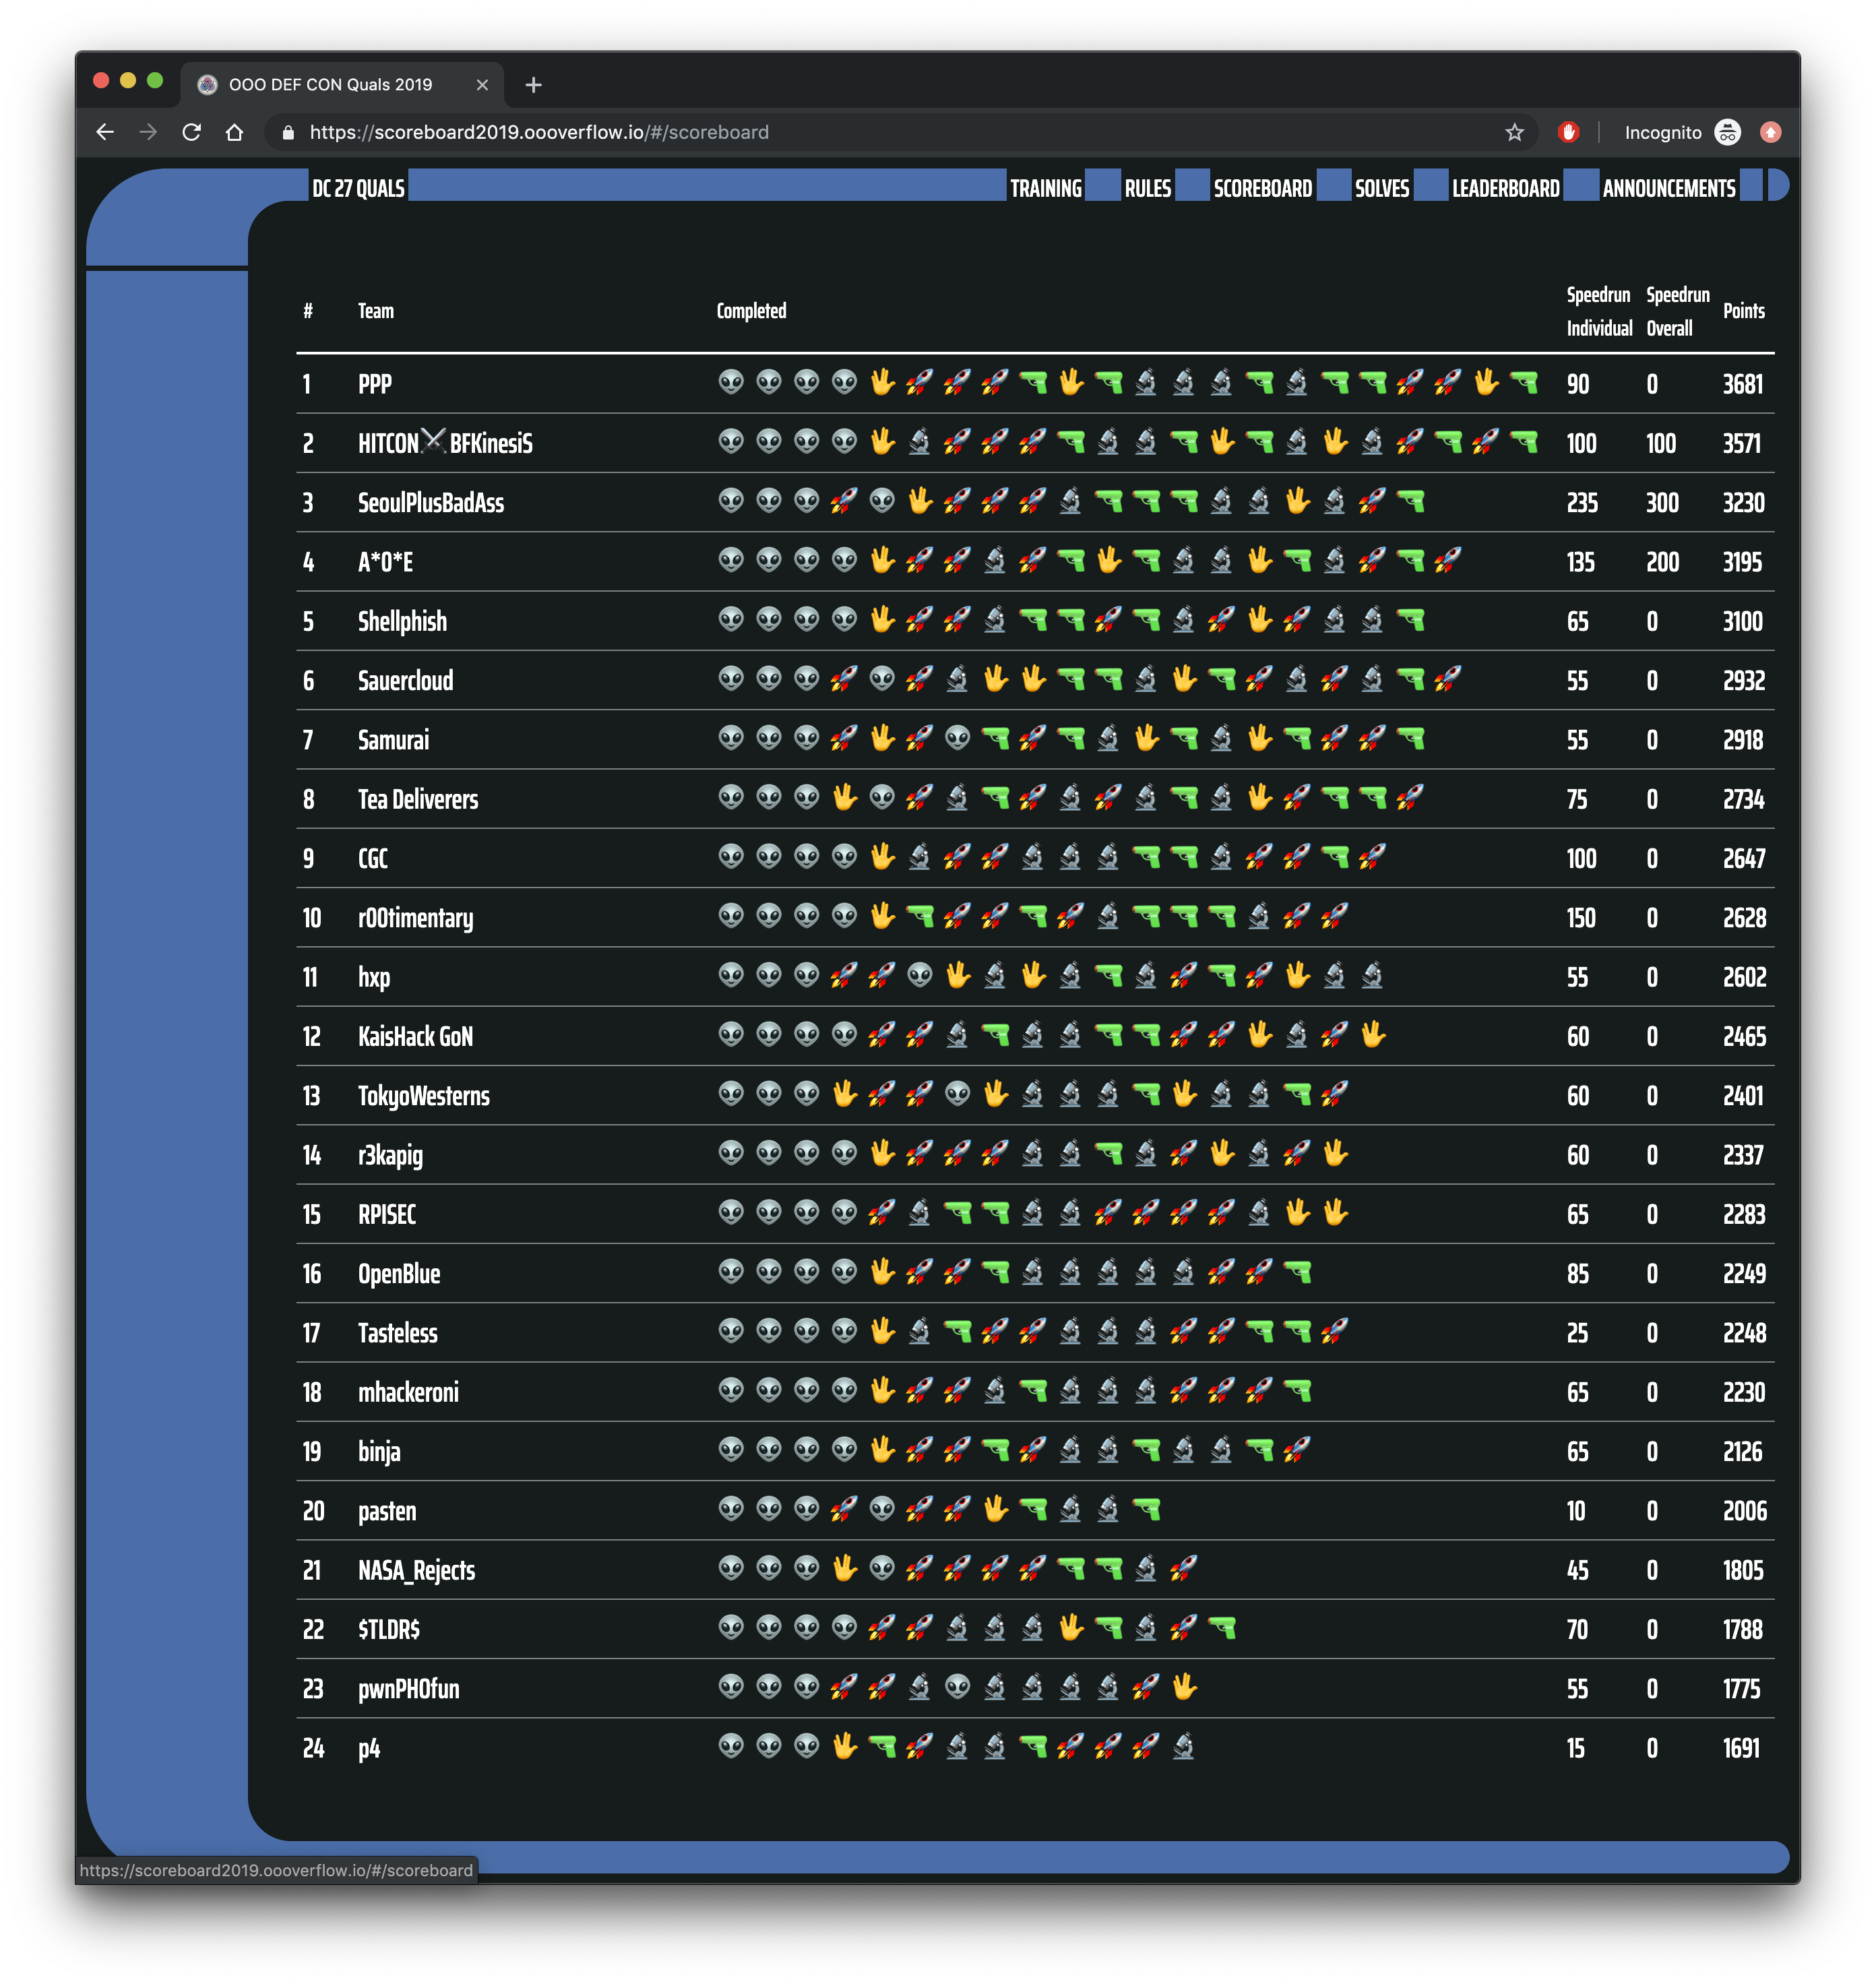

Slide 7
Road to DEF CON 27 CTF
6 qualifying CTFs from around the world
1,200 teams competed in our qualification event in May
Best 16 teams in the world invited to finals, co-located with the DEF CON security conference

Slide 8
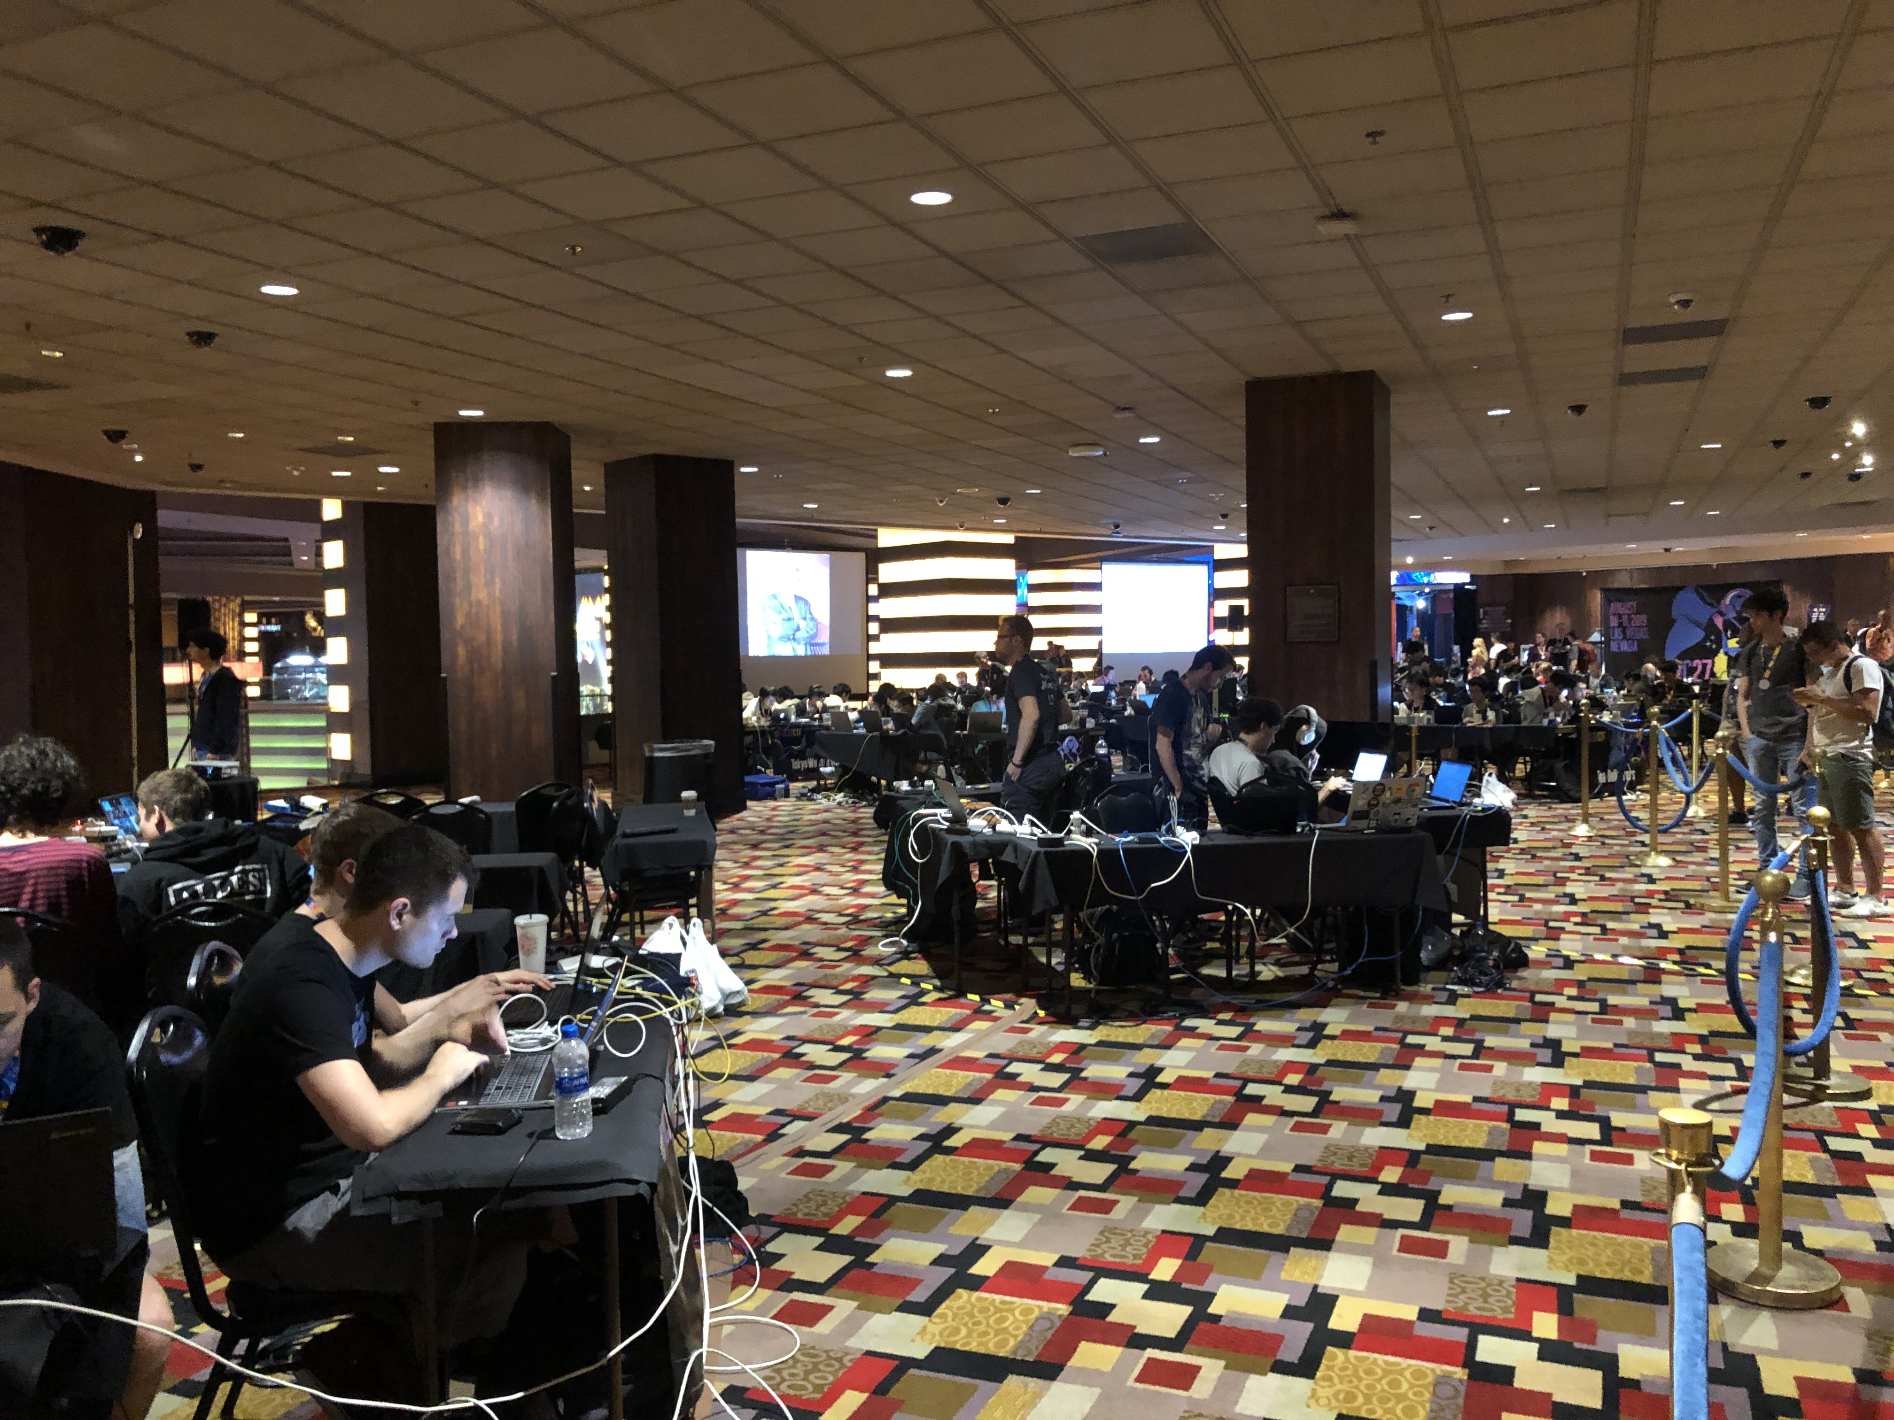

Slide 9
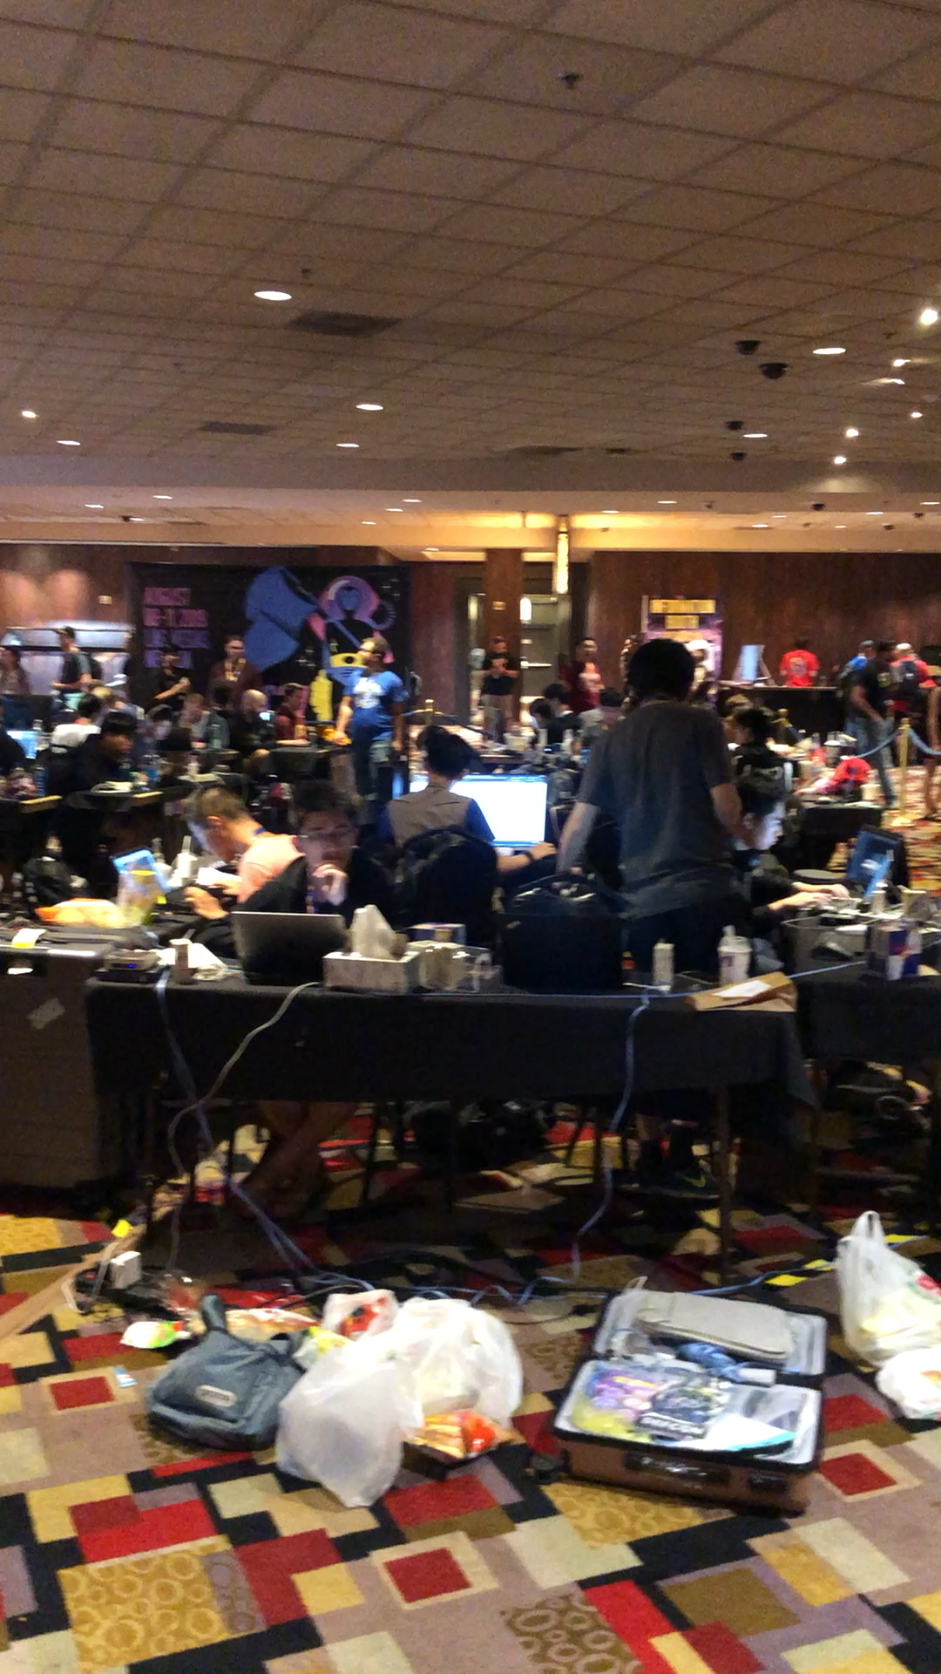

Slide 10
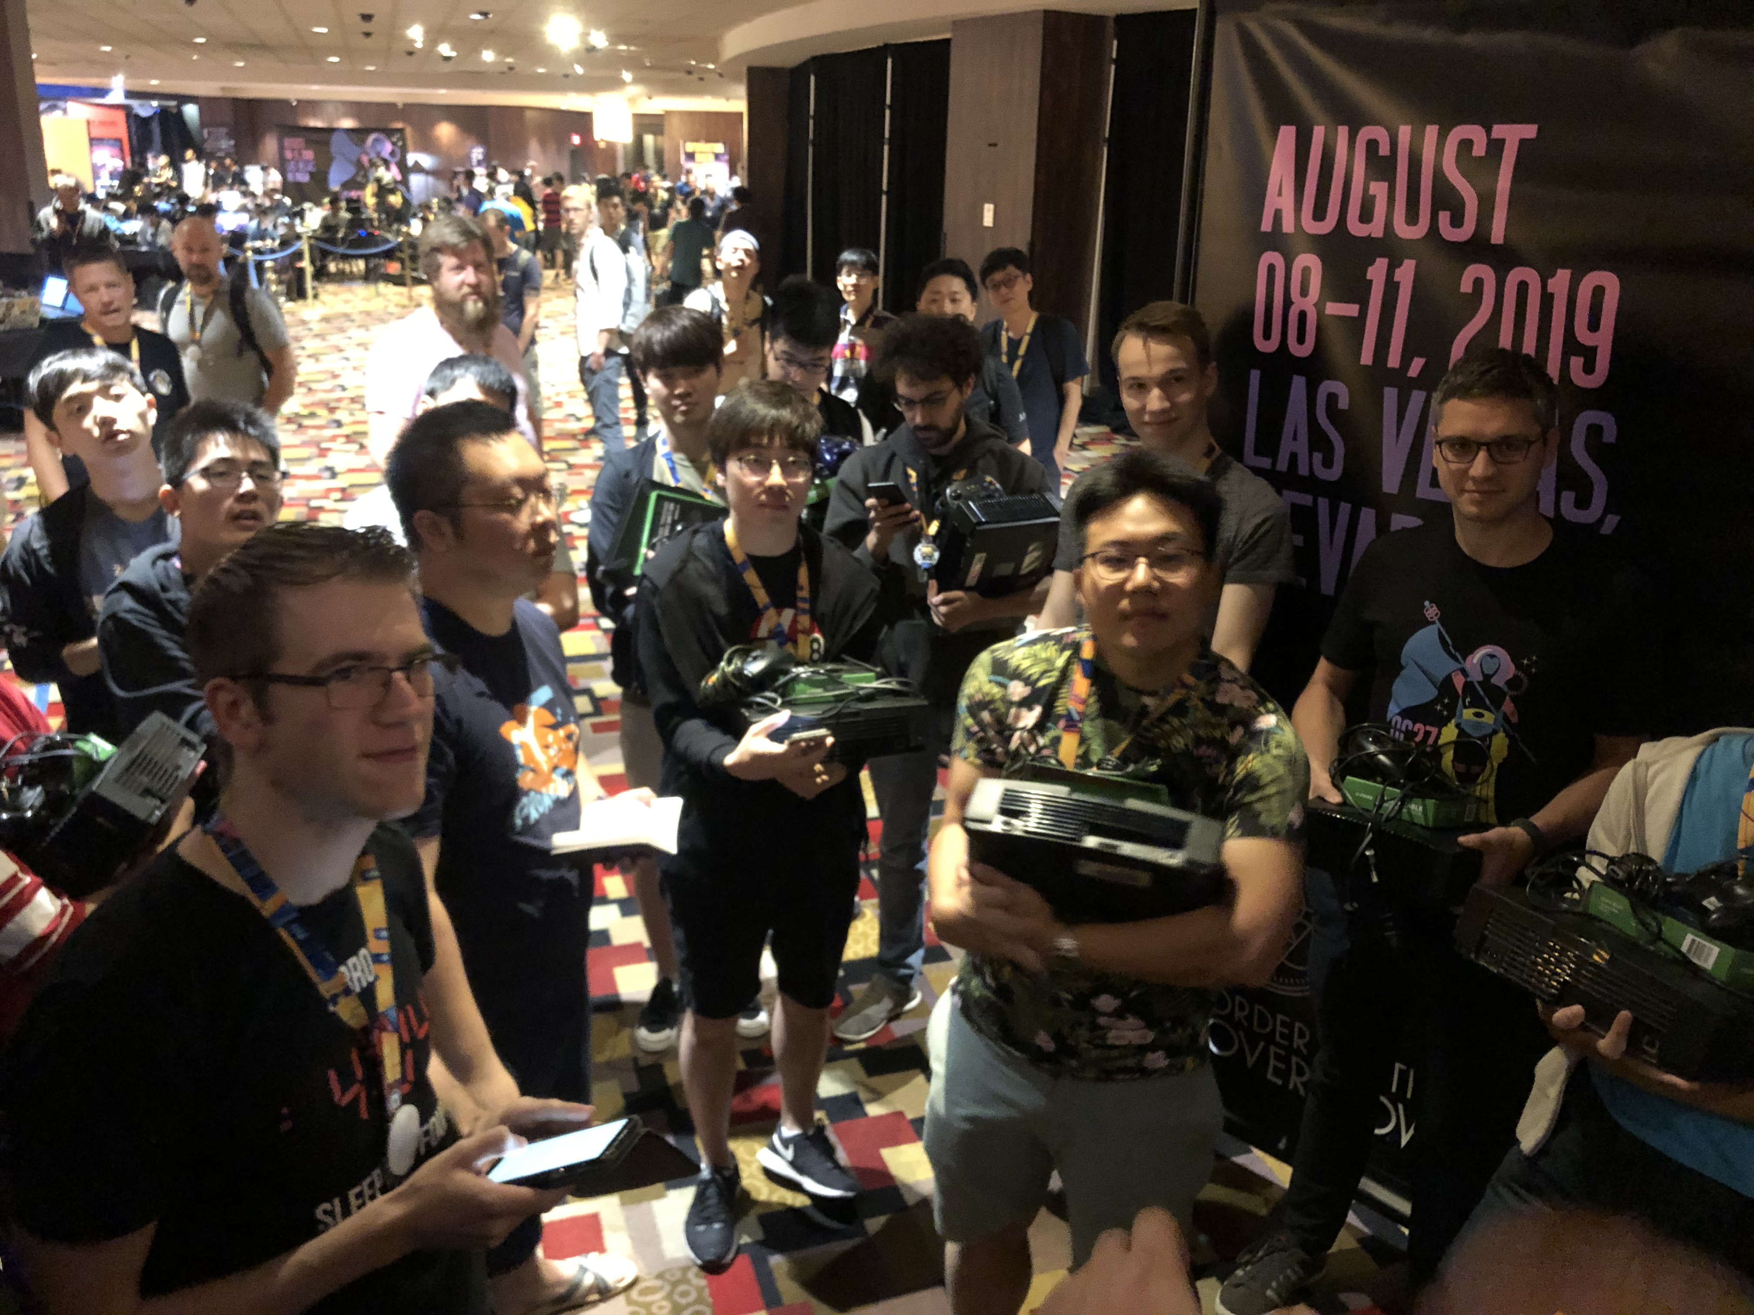

Slide 11
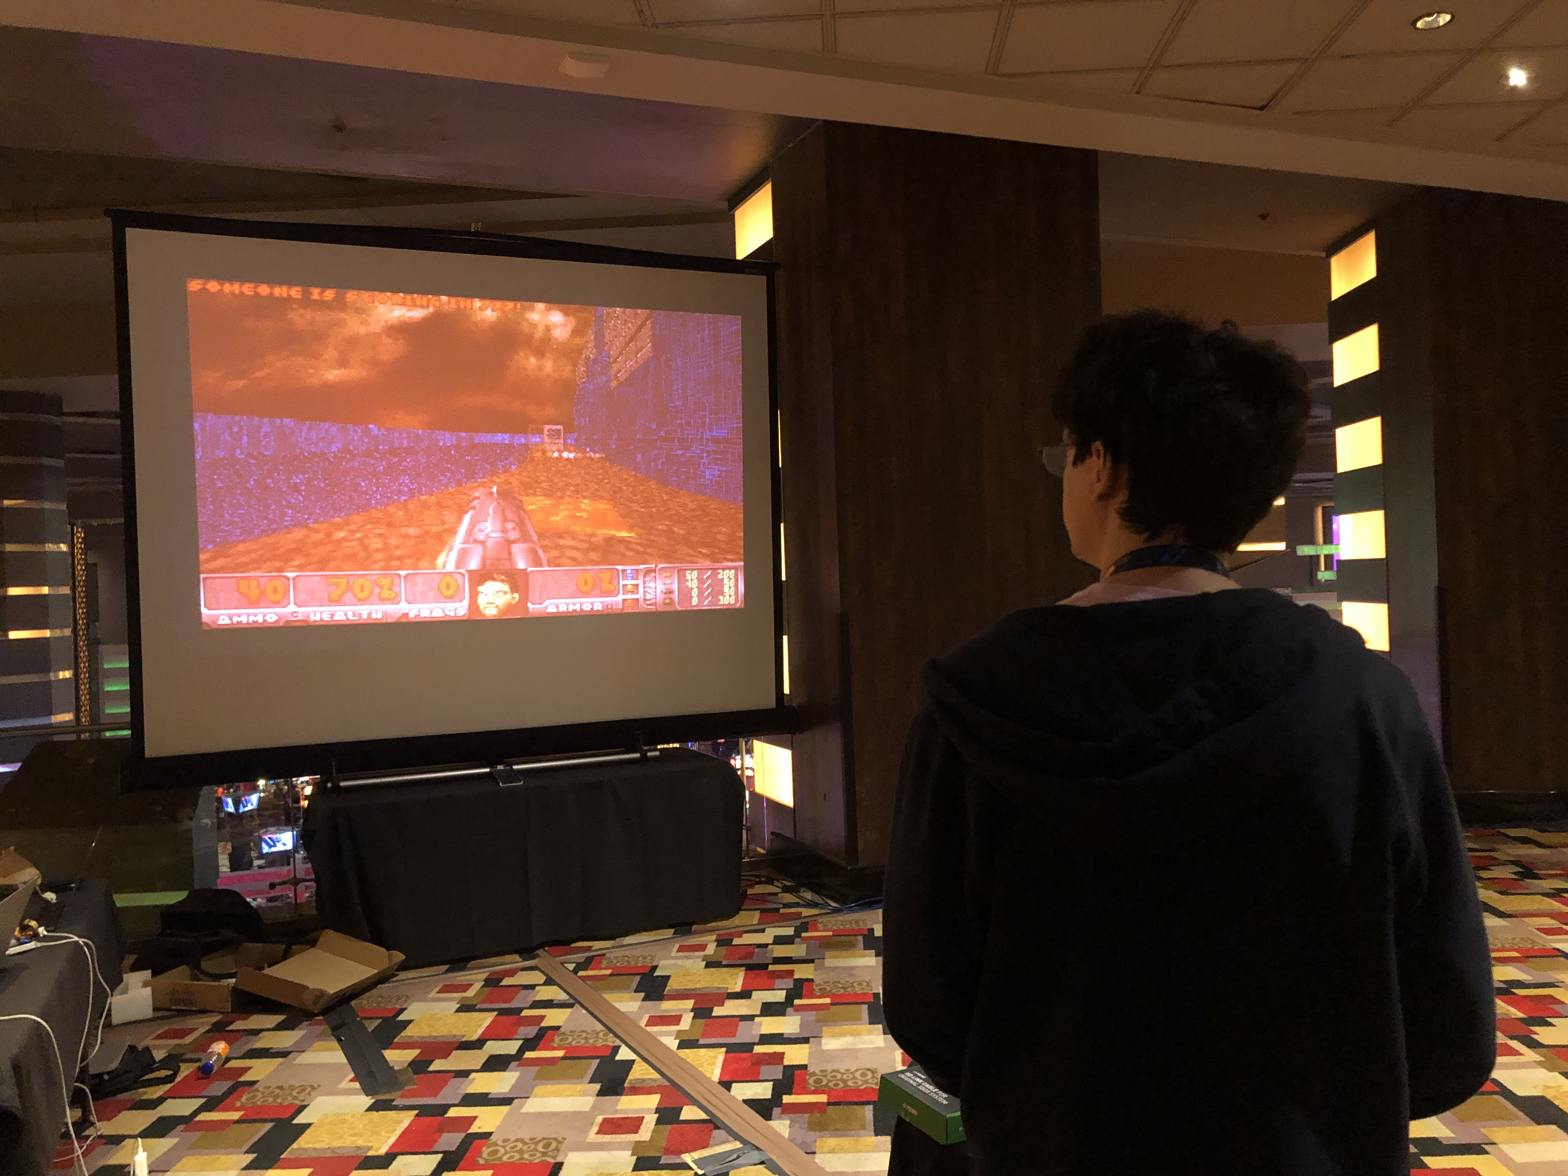

Slide 12
So what did the teams do?
Hacked iOS apps
  Via a chat app, similar to telegram
Hacked deep learning models
  Neural Networks trained on learning a flag
Hacked Lisp Machine
  Lisp Machine (from the early ‘80s) emulator running a web server
Hacked custom Doom running on Xbox
Wrote bit-flip resistant shellcode
…

Slide 14
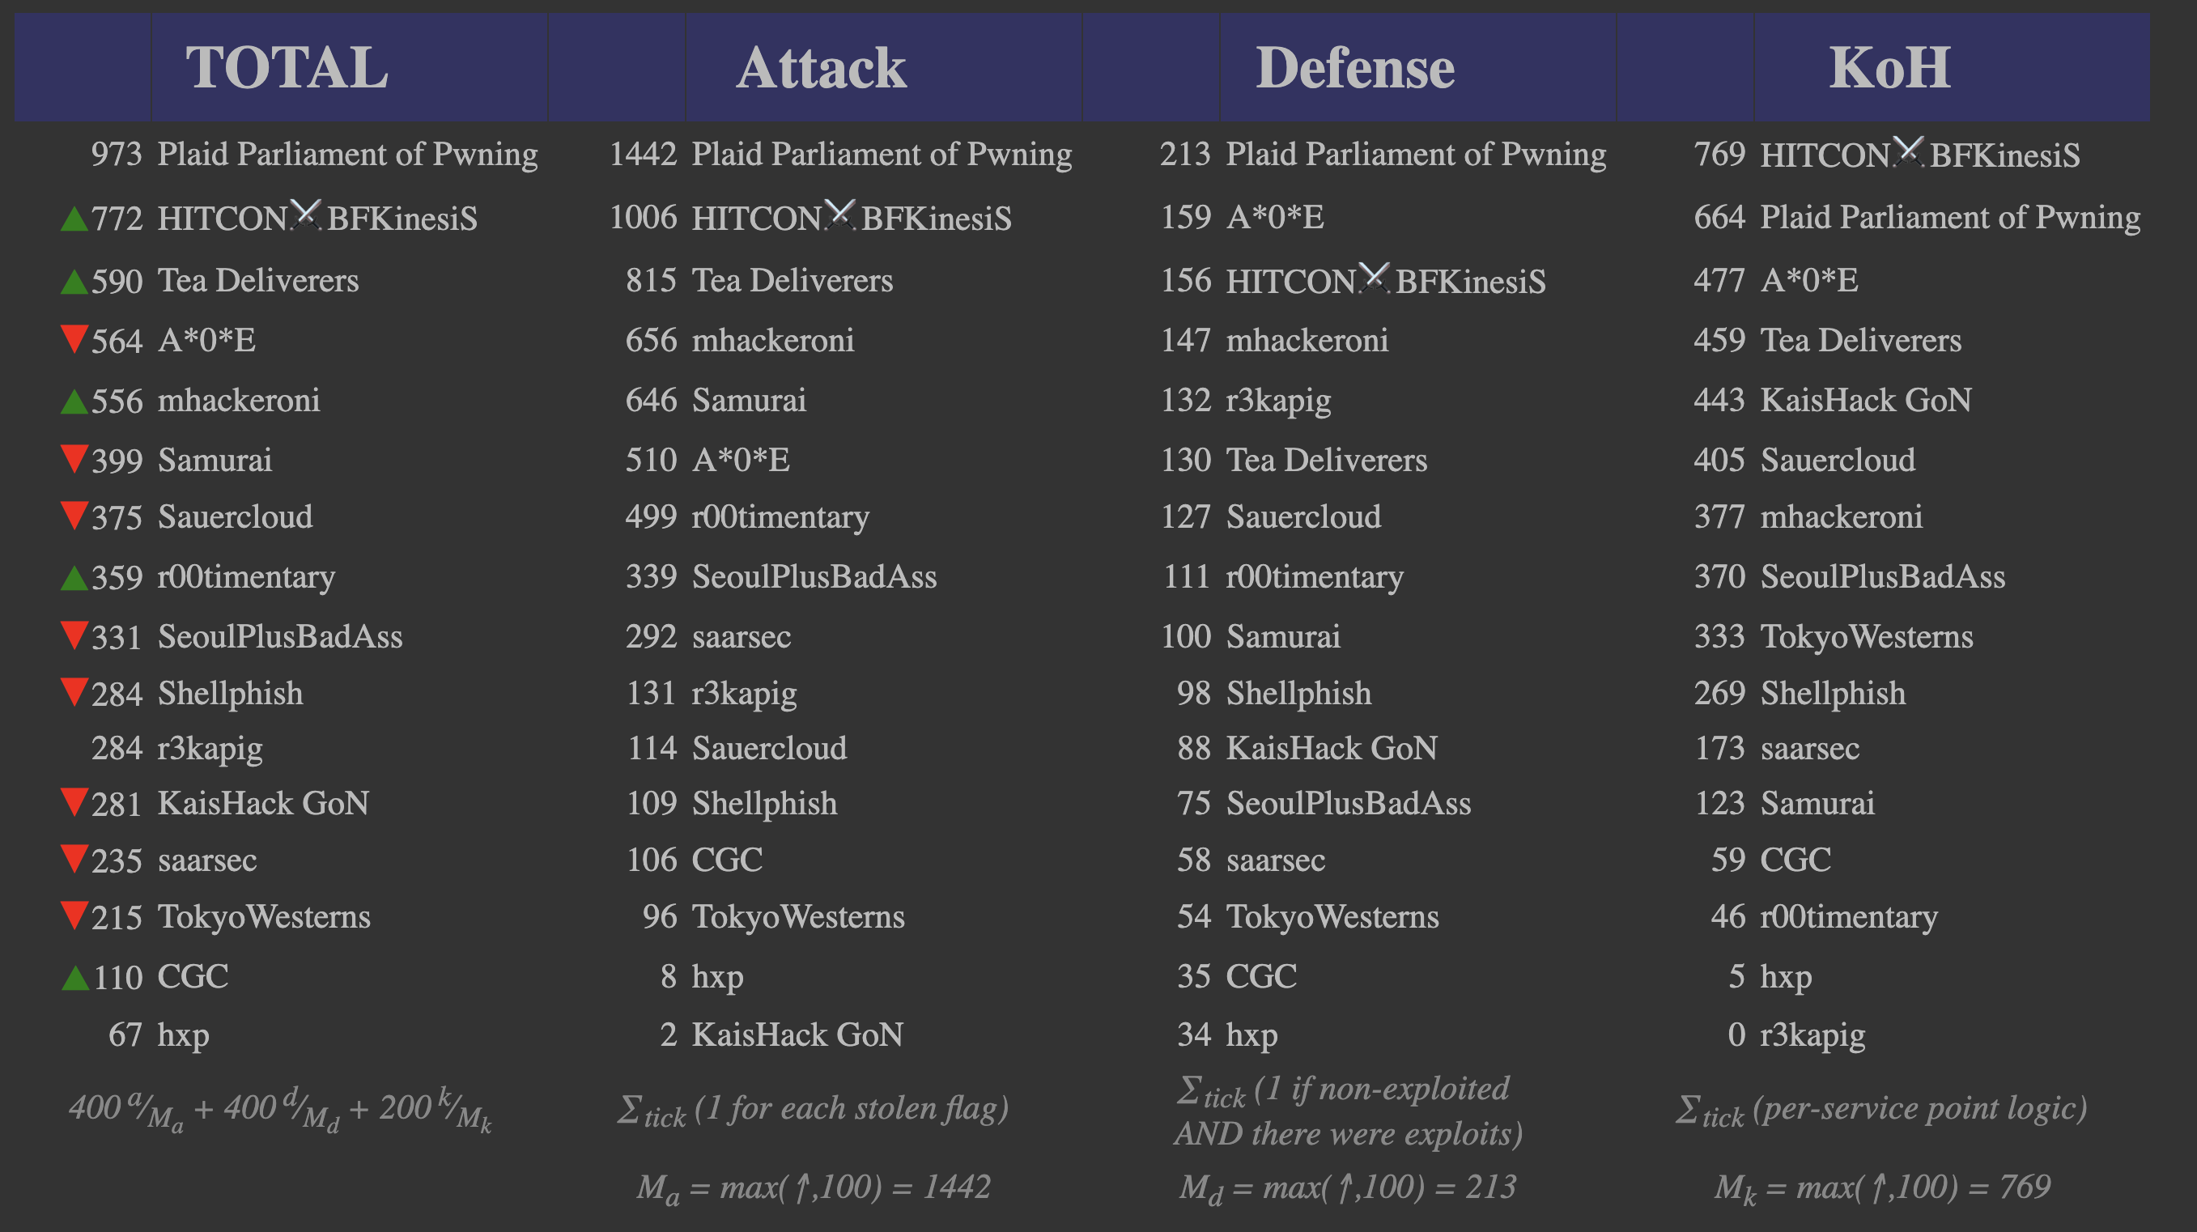

Slide 15
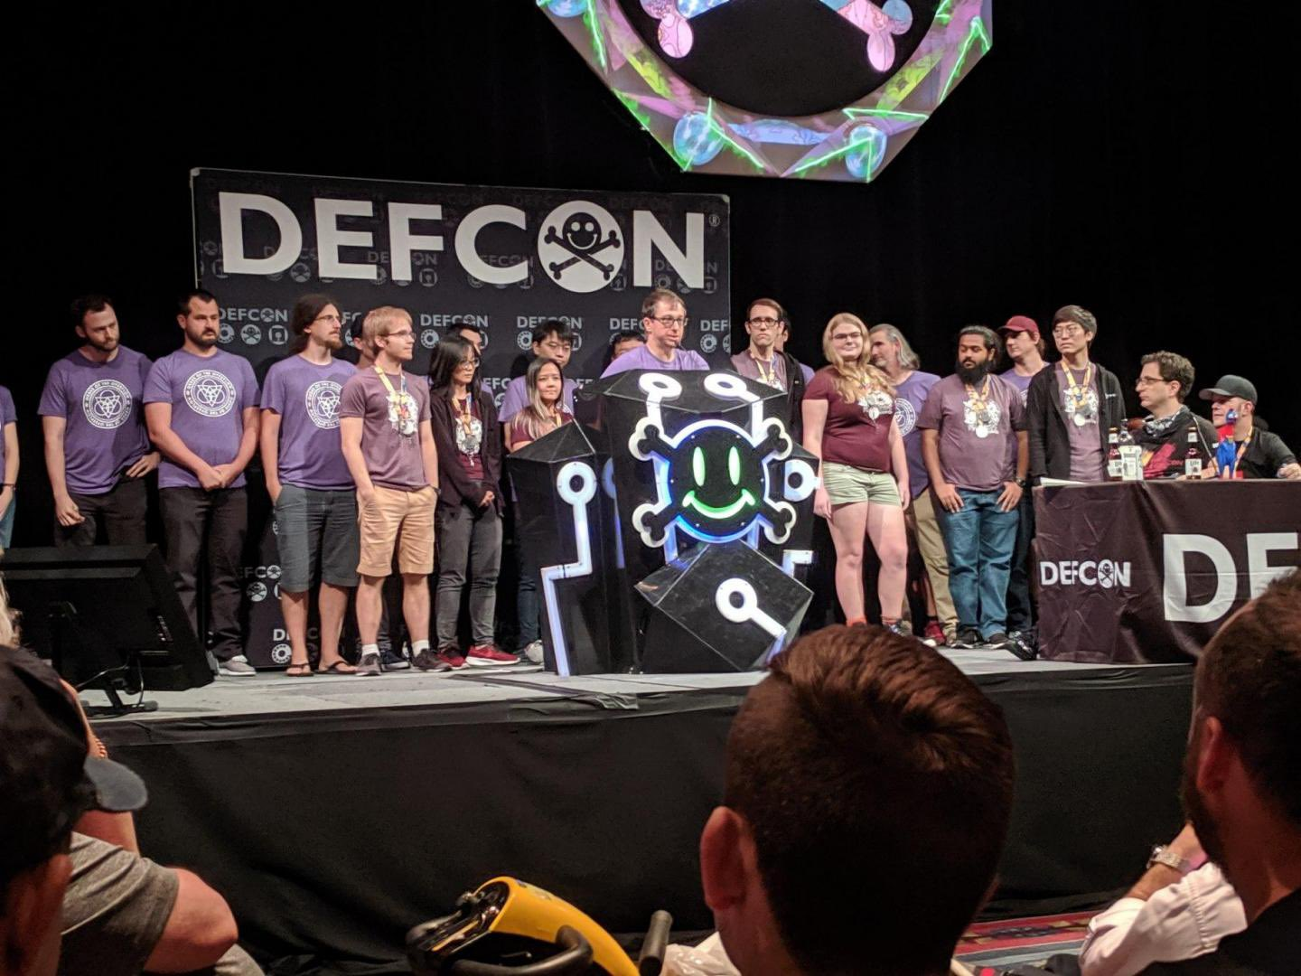

Slide 16
Security @ ASU
Two undergrad Cyber Security concentration programs
  BS in computer science
  BSE in computer systems engineering
Three graduate Cyber Security concentration programs
  MS
  MCS
  PhD
http://ia.asu.edu/education.php

Slide 17
Security @ ASU
Concentration in BS
  Minimum of 15 credits in Cyber Security and related areas as technical electives
  Core courses
    CSE 365 Introduction to Information Assurance
    CSE 466 Computer System Security
    CSE 467 Data and Information Security
    CSE 468 Network Security
    CSE 469 Computer and Network Forensics

Slide 18
Security @ ASU
NSA and DHS designated ASU and the Cyber Security program a National Center of Academic Excellence in Information Assurance Education

Slide 19
Syllabus
https://adamdoupe.com/teaching/classes/cse365-intro-information-assurance-s20/syllabus.html

