Slide 1
Threat Modeling Example
CSE 365 – Information Assurance
Fall 2018
Adam Doupé
Arizona State University
http://adamdoupe.com

Slide 2
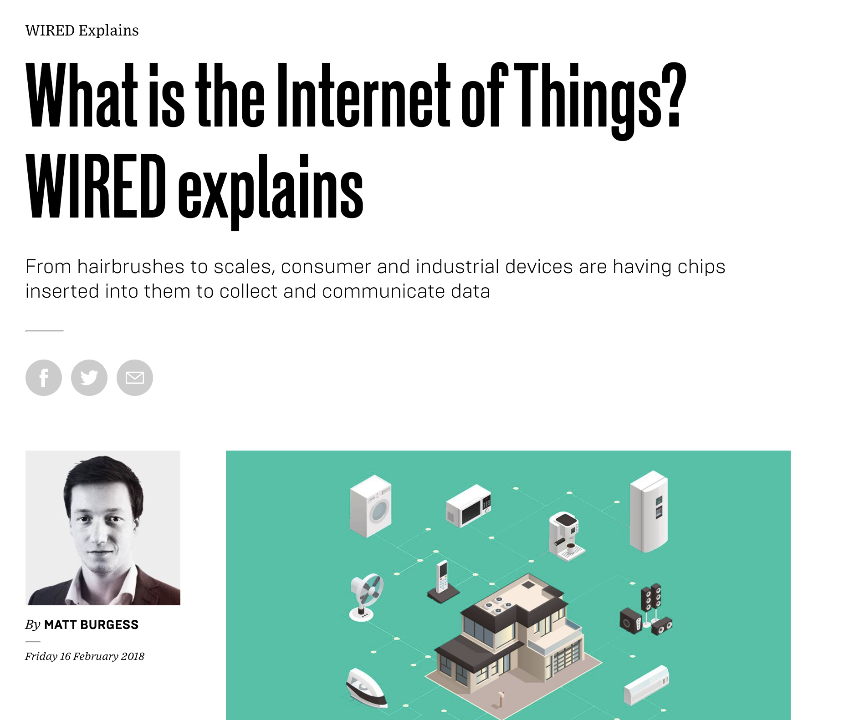
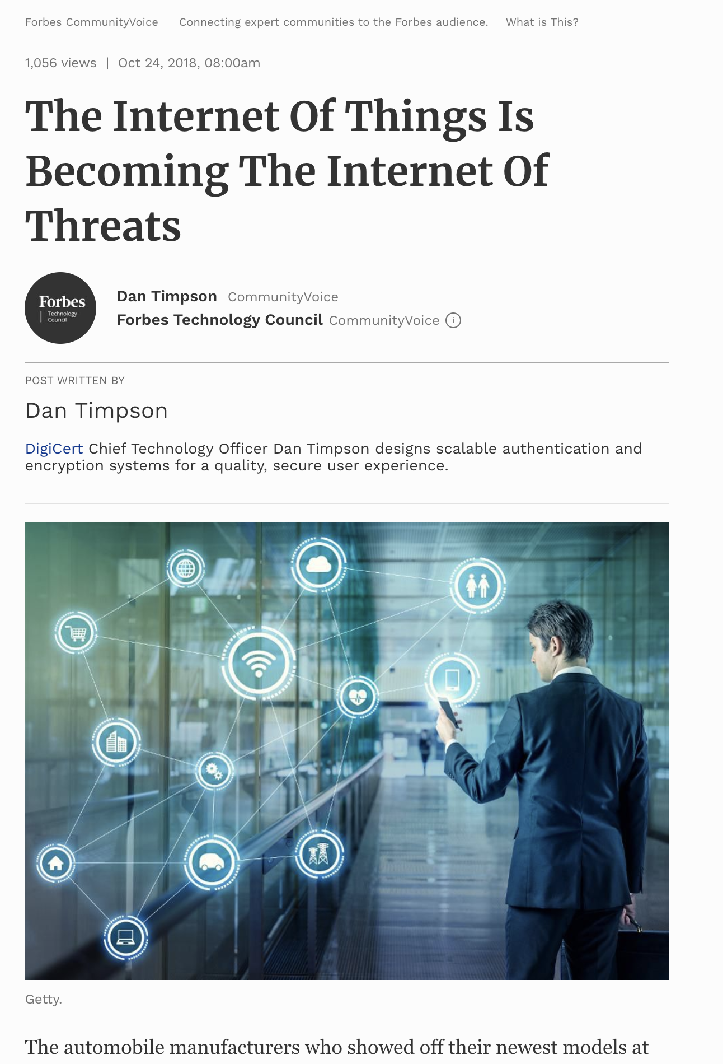
The Internet of Things

Slide 3
Large Retail Chain
10,000+ stores world wide
Refrigerator must be checked every four hours
If found over the limit, contents must be chucked
IoT?

