Slide 1
Essential Programming Skills
CSE 340 – Principles of Programming Languages
Spring 2016
Adam Doupé
Arizona State University
http://adamdoupe.com

Slide 2
Constant Learning
Searching
  Google for errors
  Finding documentation
  Navigation documentation
Reading
  Man pages
  Documentation
  Specifications

Slide 3
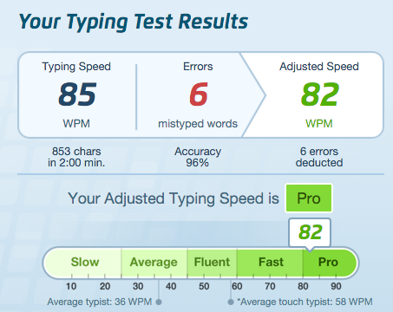
Touch Typing
Seriously, effort at this will pay dividends

Slide 4
Editors
Your editor is your main instrument to craft a program
  Chefs use the best knife
  Mechanics use the best wrenches
  Bakers use the best ovens
  And they know the ins and outs of their tool
Invest time in learning your editor

Slide 5
The Mouse is Evil
HCI Keystroke-Level Model (KLM) models how fast different user interactions can be
Pressing a key
  0.08 seconds/char fast typist
  0.28 seconds/char average typist
  1.2 seconds/char slow typist
Move hands from keyboard to mouse (or back)
  0.4 seconds
Point mouse
  0.8 -- 1.1 seconds

Slide 6
The Mouse is Evil
Using a mouse
  Move from keyboard to mouse (0.4)
  Point mouse (1.1)
  Press a left mouse button (0.08)
  Point mouse (0.8)
  Press a left mouse button (0.08)
  Move from mouse to keyboard (0.4)
  Total: 2.82 seconds
In 2.82 seconds, you could type
  35.25 characters
  10 characters
  Or 2.35 characters

Slide 7
Editors
I suggest
  vim
    Installed everywhere
    Dual mode (editing/commands)
  emacs
    Highly extensible
    Single mode (modifier keys for commands)
Whatever
  As long as you are efficient!

Slide 8
My quick emacs tips
Lots of beginner tutorials online
  http://www.jesshamrick.com/2012/09/10/absolute-beginners-guide-to-emacs/
Map caps lock to control (this is standard on every machine I use)
  Prevent "emacs pinky"
Emacs macros are amazing for data manipulation/refactoring
https://sites.google.com/site/steveyegge2/effective-emacs

Slide 9
Command Line
The UNIX/POSIX/Linux command line is an amazing tool
  Command composition
  Output redirection
  Background tasks
  Sleeping
https://en.wikipedia.org/wiki/Pipeline_(Unix)#Pipelines_in_command_line_interfaces
http://www.commandlinefu.com/commands/browse

Slide 10
Debugger
Debuggers let you inspect a running processes to find out what went wrong
Also useful tool for prototyping
  Evaluate functions and expressions in the context of the currently running program
gdb
  Command-line debugger for Linux
Knowing when to use a debugger and when to use printf is the mark of a good programmer

Slide 11
Advanced Topics
Bash scripting
  Automate frequently run tasks
Editor customization/plugins
  Shape your tool to you
Version Control
  Git, subversion
Unit Tests
  Test your code
…

