Slide 1
Semantics
CSE 340 – Principles of Programming Languages
Fall 2015
Adam Doupé
Arizona State University
http://adamdoupe.com

Slide 2
Semantics
Lexical Analysis is concerned with how to turn bytes into tokens
Syntax Analysis is concerned with specifying valid sequences of token
  Turning those sequences of tokens into a parse tree
Semantics is concerned with what that parse tree means

Slide 3
Defining Language Semantics
What properties do we want from language semantics definitions?
  Preciseness
  Predictability
  Complete
How to specify language semantics?
  English specification
  Reference implementation
  Formal language

Slide 4
English Specification
C99 language specification is 538 pages long
  "An identifier can denote an object; a function; a tag or a member of a structure, union, or enumeration; a typedef name; a label name; a macro name; or a macro parameter. The same identifier can denote different entities at different points in the program. A member of an enumeration is called an enumeration constant. Macro names and macro parameters are not considered further here, because prior to the semantic phase of program translation any occurrences of macro names in the source file are replaced by the preprocessing token sequences that constitute their macro definitions."
In general, can be ambiguous, not correct, or ignored
What about cases that the specification does not mention?
However, good for multiple implementations of the same language

Slide 5
Reference Implementation
Until the official Ruby specification in 2011, the Ruby MRI (Matz's Ruby Interpreter) was the reference implementation
Any program that the reference implementation run is a Ruby program, and it should do whatever the reference implementation does
Precisely specified on a given input
  If there is any question, simply run a test program on a sample implementation
However, what about bugs in the reference?
  Most often, they become part of the language
What if the reference implementation does not run on your platform?

Slide 6
Formal Specification
Specify the semantics of the language constructs formally (different approaches)
In this way, all parts of the language have an exact definition
  Allows for proving properties about the language and programs written in the language
However, can be difficult to understand

Slide 7
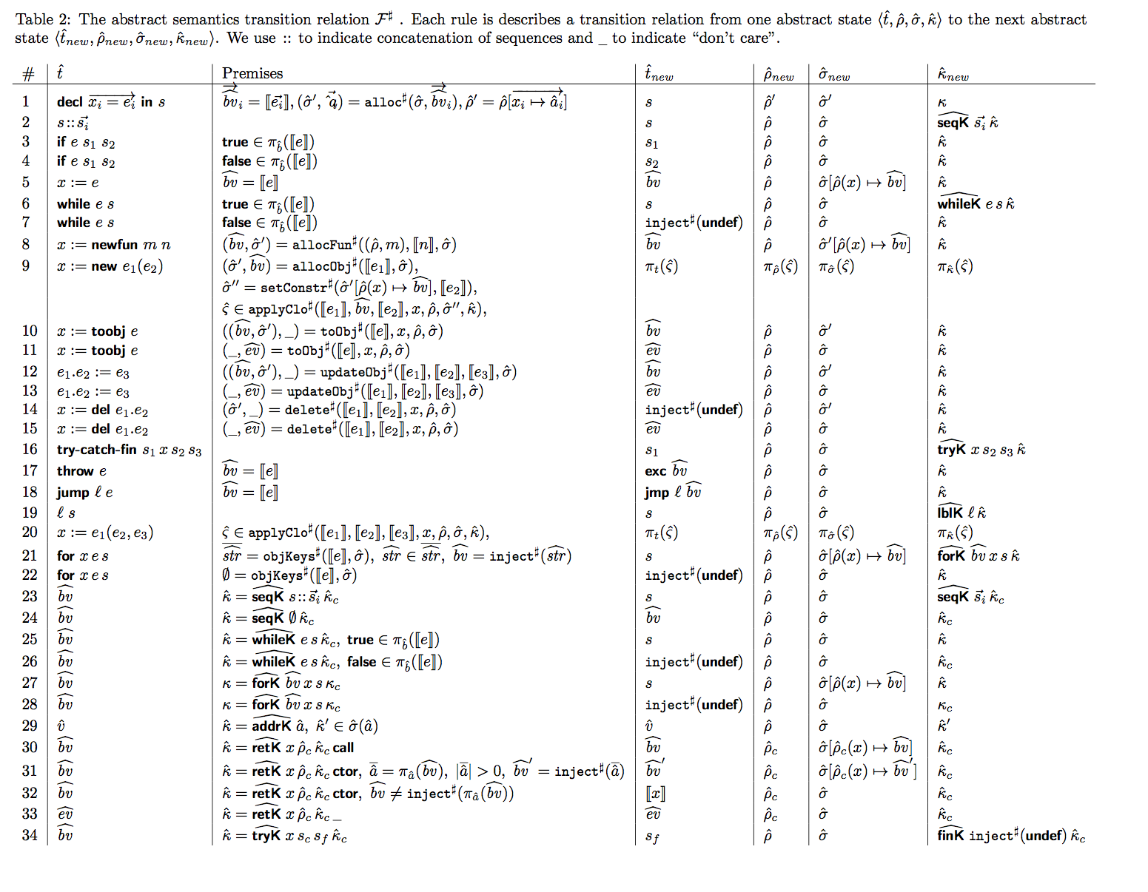
Table courtesy of Vineeth Kashyap and Ben Hardekopf

Slide 8
Semantics
Many of the language's syntactic constructions need semantic meaning
  variable
  function
  parameter
  type
  operators
  exception
  control structures
  constant
  method
  class

Slide 9
Declarations
Some constructs must first be introduced by explicit declarations
  Often the declarations are associated with a specific name
  int i;
However, some constructs can be introduced by implicit declarations
  target = test_value + 10

Slide 10
What's in a name?
Main question is, once a name is declared, how long is that declaration valid?
  Entire program?
  Entire file?
  Global?
    Android app package names are essentially global
    com.facebook.katana
  Function?
Related question is how to map a name to a declaration
Scope is the semantics behind
  How long a declaration is valid
  How to resolve a name

Slide 11
C Scoping
C uses block-level scoping
  Declarations are valid in the block that they are declared
  Declarations not in a block are global, unless the static keywords is used, in which case the declaration is valid in that file only
JavaScript uses function-level scoping
  Declarations are valid in the function that they are declared

Slide 12
#include <stdio.h>
int main()
{
{
int i;
i = 10000;
printf("%d\n", i);
}
{
printf("%d\n", i);
}
}
[adamd@ragnuk examples]$ gcc -Wall test_scope.c
test_scope.c: In function ‘main’:
test_scope.c:11: error: ‘i’ undeclared (first use in this function)
test_scope.c:11: error: (Each undeclared identifier is reported only once
test_scope.c:11: error: for each function it appears in.)

Slide 13
#include <stdio.h>
int main()
{
{
int i;
i = 10000;
printf("%d\n", i);
}
{
int i;
printf("%d\n", i);
}
}
[adamd@ragnuk examples]$ gcc test_scope.c
[adamd@ragnuk examples]$ ./a.out
100000
0
[hedwig examples]$ gcc test_scope.c
[hedwig examples]$ ./a.out
10000
1669615670

Slide 14
Resolving a Name
When we see a name, we need to map the name to the declaration
  We do this using a data structure called a Symbol Table
    Maps names to declarations and attributes
Static Scoping
  Resolution of name to declaration is done statically
  Symbol Table is created statically
Dynamic Scoping
  Resolution of name to declaration is done dynamically at run-time
  Symbol Table is created dynamically

Slide 15
#include <stdio.h>
int x;
void bar();
void foo() {
char c = 'c';
bar();
printf("%d %c\n", x, c);
}
void baz() {
printf("%d\n", x);
x = 1337;
}
void bar() {
int x = 100;
baz();
}
int main() {
x = 10;
{
char* x = "testing";
printf("%s\n", x);
}
foo();
}

Slide 16
#include <stdio.h>
int x;
void bar();
void foo() {
char c = 'c';
bar();
printf("%d %c\n", x, c);
}
void baz() {
printf("%d\n", x);
x = 1337;
}
void bar() {
int x = 100;
baz();
}
int main() {
x = 10;
{
char* x = "testing";
printf("%s\n", x);
}
foo();
}
char c
int x;
void bar();
void foo()
int x
char* x

Slide 17
#include <stdio.h>
int x;
void bar();
void foo() {
char c = 'c';
bar();
printf("%d %c\n", x, c);
}
void baz() {
printf("%d\n", x);
x = 1337;
}
void bar() {
int x = 100;
baz();
}
int main() {
x = 10;
{
char* x = "testing";
printf("%s\n", x);
}
foo();
}
char c
int x;
void bar();
void foo()
int x
char* x

Slide 18
#include <stdio.h>
int x;
void bar();
void foo() {
char c = 'c';
bar();
printf("%d %c\n", x, c);
}
void baz() {
printf("%d\n", x);
x = 1337;
}
void bar() {
int x = 100;
baz();
}
int main() {
x = 10;
{
char* x = "testing";
printf("%s\n", x);
}
foo();
}
[adamd@ragnuk examples]$ gcc -Wall static_scoping.c
[adamd@ragnuk examples]$ ./a.out
testing
10
1337 c

Slide 19
Dynamic Scoping
In dynamic scoping, the symbol table is created and updated at run-time
When resolving name x, dynamic lookup of the symbol table for the last encounter declaration of x
Thus, x could change depending on how a function is called!
Common Lisp allows both dynamic and lexical scoping

Slide 20
#include <stdio.h>
int x;
void bar();
void foo() {
char c = 'c';
bar();
printf("%d %c\n", x, c);
}
void baz() {
printf("%d\n", x);
x = 1337;
}
void bar() {
int x = 100;
baz();
}
int main() {
x = 10;
{
char* x = "testing";
printf("%s\n", x);
}
foo();
}
x | int
bar | <void>
foo | <void>, line 4
baz | <void>, line 9

Slide 21
#include <stdio.h>
int x;
void bar();
void foo() {
char c = 'c';
bar();
printf("%d %c\n", x, c);
}
void baz() {
printf("%d\n", x);
x = 1337;
}
void bar() {
int x = 100;
baz();
}
int main() {
x = 10;
{
char* x = "testing";
printf("%s\n", x);
}
foo();
}
x | int
bar | <void>
foo | <void>, line 4
baz | <void>, line 9

Slide 22
#include <stdio.h>
int x;
void bar();
void foo() {
char c = 'c';
bar();
printf("%d %c\n", x, c);
}
void baz() {
printf("%d\n", x);
x = 1337;
}
void bar() {
int x = 100;
baz();
}
int main() {
x = 10;
{
char* x = "testing";
printf("%s\n", x);
}
foo();
}
x | int
bar | <void>, line 13
foo | <void>, line 4
baz | <void>, line 9
main | <void>, line 17

Slide 23
#include <stdio.h>
int x;
void bar();
void foo() {
char c = 'c';
bar();
printf("%d %c\n", x, c);
}
void baz() {
printf("%d\n", x);
x = 1337;
}
void bar() {
int x = 100;
baz();
}
int main() {
x = 10;
{
char* x = "testing";
printf("%s\n", x);
}
foo();
}
x | int | 10
bar | <void>, line 13
foo | <void>, line 4
baz | <void>, line 9
main | <void>, line 17
x | char* | testing

Slide 24
#include <stdio.h>
int x;
void bar();
void foo() {
char c = 'c';
bar();
printf("%d %c\n", x, c);
}
void baz() {
printf("%d\n", x);
x = 1337;
}
void bar() {
int x = 100;
baz();
}
int main() {
x = 10;
{
char* x = "testing";
printf("%s\n", x);
}
foo();
}
x | int | 10
bar | <void>, line 13
foo | <void>, line 4
baz | <void>, line 9
main | <void>, line 17

Slide 25
#include <stdio.h>
int x;
void bar();
void foo() {
char c = 'c';
bar();
printf("%d %c\n", x, c);
}
void baz() {
printf("%d\n", x);
x = 1337;
}
void bar() {
int x = 100;
baz();
}
int main() {
x = 10;
{
char* x = "testing";
printf("%s\n", x);
}
foo();
}
x | int | 10
bar | <void>, line 13
foo | <void>, line 4
baz | <void>, line 9
main | <void>, line 17
c | char | c
x | int | 100

Slide 26
#include <stdio.h>
int x;
void bar();
void foo() {
char c = 'c';
bar();
printf("%d %c\n", x, c);
}
void baz() {
printf("%d\n", x);
x = 1337;
}
void bar() {
int x = 100;
baz();
}
int main() {
x = 10;
{
char* x = "testing";
printf("%s\n", x);
}
foo();
}
x | int | 10
bar | <void>, line 13
foo | <void>, line 4
baz | <void>, line 9
main | <void>, line 17
c | char | c
x | int | 1337

Slide 27
#include <stdio.h>
int x;
void bar();
void foo() {
char c = 'c';
bar();
printf("%d %c\n", x, c);
}
void baz() {
printf("%d\n", x);
x = 1337;
}
void bar() {
int x = 100;
baz();
}
int main() {
x = 10;
{
char* x = "testing";
printf("%s\n", x);
}
foo();
}
[adamd@ragnuk examples]$ dynamic_gcc -Wall static_scoping.c
[adamd@ragnuk examples]$ ./a.out
testing
100
10 c

Slide 28
Function Resolution
How to resolve function calls to appropriate functions?
  Names?
  Names + return type?
  Names + parameter number?
  Names + parameter number + parameter types?
Disambiguation rules are often referred to as the function signature
Vary by programming language
  In C, function signatures are names only
    <name>
  In C++, function signatures are names and parameter types
    <name, type_param_1, type_param_2, …>

Slide 29
Function Resolution (C++)
#include <stdio.h>
int foo()
{
return 10;
}
int foo(int x)
{
return 10 + x;
}
int main()
{
int test = foo();
int bar = foo(test);
printf("%d %d\n", test, bar);
}

Slide 30
Function Resolution (C++)
#include <stdio.h>
int foo()
{
return 10;
}
int foo(int x)
{
return 10 + x;
}
int main()
{
int test = foo();
int bar = foo(test);
printf("%d %d\n", test, bar);
}
[adamd@ragnuk examples]$ g++ -Wall function_resolution.cpp
[adamd@ragnuk examples]$ ./a.out
10 20

Slide 31
Assignment Semantics
What are the exact semantics behind the following statement
  x = y
Depends on the programming language
We need to define four concepts
  Name
    A name used to refer to a declaration
  Location
    A container that can hold a value
  Binding
    Association between a name and a location
  Value
    An element from a set of possible values

Slide 32
Assignment Semantics Using Box and Circle Diagrams
int x;
Name, binding, location, value
x

Slide 33
Assignment Semantics
int x;
x = 5;
  Copy the value 5 to the location associated with the name x
5
x
5

Slide 34
Assignment Semantics
int x;
int y;
x = y;
  Copy the value in the location associated with y to the location associated with x
x
y

Slide 35
Assignment Semantics
int x;
x = x;
  Copy the value in the location associated with x to the location associated with x
x

Slide 36
Assignment Semantics
l-value = r-value
l-value
  An expression is an l-value if there is a location associated with the expression
r-value
  An expression is an r-value if the expression has a value associated with the expression
x = 5
  l-value = r-value: Copy the value in r-value to the location in l-value
5 = x
  r-value = l-value: not semantically valid!
l-value₁ = l-value₂
  Copy value in location associated with l-value₂ to location associated with l-value₁

Slide 37
Assignment Semantics
a = b + c
  a: an l-value
  b + c
    r-value: value in the location associated with b + value in location associated with c is a value
  Copy value associated with b + c to location associated with a

Slide 38
Pointer Operations
Address operator &
  Unary operator
  Can only be applied to an l-value
  Result is an r-value of type T*, where T is the type of the operand
  Value is the address of the location associated with the l-value that & was applied to
Dereference operator *
  Unary operator
  Can be applied to an l-value or an r-value of type T*

Slide 39
Dereference Operator *
If x is of type T*, then the box and circle diagram is the following
Where x_{v} is the address of a location that contains a value v of type T
x
x_{v}
&x
*x
v
x_{v}

Slide 40
l-value
  An expression is an l-value if there is a location associated with the expression
r-value
  An expression is an r-value if the expression has a value associated with the expression
Is *x an l-value?
  Yes, *x is the location associated with *x, which is the location whose address is the value of the location associated with x (which in this case is x_{v})
What are the semantics of *x = 100?
  Copy the value 100 to the location associated with *x
x
x_{v}
&x
100
*x
v
x_{v}
100

Slide 41
Pointer Semantics
x
10
y
z
y
int x;
int z;
z = (int) &x;
*&x = 10;
x = *&x;

Slide 42
int **x;
int *y;
int z;
x = (int **) malloc(sizeof(int*));
y = (int *) malloc(sizeof(int));
x = &y;
y = &z;
y = *x;
0x4
*x
x
0x4
*y
0x8
y
0x8
z

Slide 43
int **x;
int *y;
int z;
x = (int **) malloc(sizeof(int*));
y = (int *) malloc(sizeof(int));
x = &y;
y = &z;
y = *x;
0x4
*x
x
ad_{y}
0x4
ad_{x}
*y
0x8
*x
y
0x8
ad_{y}
z
ad_{z}

Slide 44
int **x;
int *y;
int z;
x = (int **) malloc(sizeof(int*));
y = (int *) malloc(sizeof(int));
x = &y;
y = &z;
y = *x;
z = 10;
printf("%d\n", **x);
y* = 100;
printf("%d\n", z);
*y and z are aliases
  An alias is when two l-values have the same location associated with them
What are the other aliases at the end of program execution?
  **x, y*, z
  *x, y
0x4
x
ad_{y}
ad_{x}
*y
0x8
*x
y
ad_{z}
ad_{y}
0x8
*y
z
100
ad_{z}
10

Slide 45
Memory Allocation
How to create new locations and reserve the associated address
  Finding memory that is not currently reserved
  Either associating that memory with a variable name or reserving the memory and returning the address of the memory
Memory Deallocation
  How to release locations and associated addresses so that they may be reused later in program execution

Slide 46
Types of Memory Allocation
Global allocation
  Allocation is done once and the allocated memory is not deallocated
Stack allocation
  Allocation is associated with nested scopes and functions calls, reserved memory is automatically deallocated when out-of-scope
Heap allocation
  Allocation is explicitly requested by the program (malloc and new)

Slide 47
#include <stdio.h>
int x;
void bar();
void foo() {
char c = 'c';
bar();
printf("%d %c\n", x, c);
}
void baz() {
printf("%d\n", x);
x = 1337;
}
void bar() {
int* x = (int*)malloc(sizeof(int));
baz();
}
int main() {
x = 10;
{
char* x = "testing";
printf("%s\n", x);
}
foo();
}

Slide 48
Memory Errors
Dangling Reference
  Reference to a memory address that was originally allocated, but is now deallocated
Garbage
  Memory that has been allocated on the heap and has not been explicitly deallocated, yet is not accessible by the program

Slide 49
#include <stdio.h>
int* foo(){
int x = 100;
return &x;
}
void bar(){
int y = 10000;
int z = 0;
printf("%d %d\n", y, z);
}
int main(){
int* dang;
dang = foo();
printf("%p %d\n", dang, *dang);
bar();
printf("%p %d\n", dang, *dang);
}
[ragnuk]$ gcc -Wall dangling_reference.c
dangling_reference.c: In function ‘foo’:
dangling_reference.c:6: warning: function returns address of local variable
[ragnuk]$ ./a.out
0x7ffe3e680ffc 100
10000 0
0x7ffe3e680ffc 0

Slide 50
#include <stdio.h>
int* foo(){
int x = 100;
return &x;
}
void bar(){
int y = 10000;
int z = 0;
printf("%d %d\n", y, z);
}
int main(){
int* dang;
dang = foo();
printf("%p %d\n", dang, *dang);
bar();
printf("%p %d\n", dang, *dang);
}
[hedwig]$ gcc -Wall dangling_reference.c
dangling_reference.c:6:12: warning: address of stack memory associated with local variable 'x' returned [-Wreturn-stack-address]
return &x;
^
1 warning generated.
[hedwig]$ ./a.out
0x7fff55adb68c 100
10000 0
0x7fff55adb68c 10000

Slide 51
#include <stdio.h>
#include <stdlib.h>
int main() {
int* dang;
int* foo;
dang = (int*)malloc(sizeof(int));
foo = dang;
*foo = 100;
free(foo);
printf("%d\n", *dang);
foo = (int*)malloc(sizeof(int));
*foo = 42;
free(foo);
printf("%d\n", *dang);
}
[ragnuk]$ gcc -Wall dangling_free.c
[ragnuk examples]$ ./a.out
0
0

Slide 52
#include <stdio.h>
#include <stdlib.h>
int main() {
int* dang;
int* foo;
dang = (int*)malloc(sizeof(int));
foo = dang;
*foo = 100;
free(foo);
printf("%d\n", *dang);
foo = (int*)malloc(sizeof(int));
*foo = 42;
free(foo);
printf("%d\n", *dang);
}
[hedwig]$ gcc -Wall dangling_free.c
[hedwig]$ ./a.out
100
42

Slide 53
#include <stdlib.h>
int** q;
int main() {
int* a;
{
int* b;
a = (int*) malloc(sizeof(int)); // memory 1
b = (int*) malloc(sizeof(int)); // memory 2
*a = 42;
// point 1
b = (int*) malloc(sizeof(int)); // memory 3
*b = *a;
q = &a;
// point 2
}
// point 3
}

Slide 54
Assignment Semantics
Copy Semantics
  a = b;
  Copy the value in the location associated with b to the value in the location associated with a
Sharing Semantics
  a = b;
  Bind the name b to the location associated with a

Slide 55
Sharing Semantics
Object a;
Object b;
a = new Object();
b = new Object();
a = new Object();
b = a;
a
b

